Slide 1
INFORMATION EVENING
March 7th 2018
St. Anne's community college
SENIOR CHOICES

Slide 2
OPTIONS
Ty
OR
Leaving Cert

Slide 3
Outline
4th Year Information
Questions & Answers
TY information
Questions & Answers

Slide 4
What we’re doing….
3rd Year briefings on subjects from staff
Presentation from Guidance Counsellor
Interest questionnaire
Websites to research
Parents Information evening
Appointments as required
Presentation will be available to download from www.killaloecc.ie under the ‘Parents’ tab

Slide 5

Choices

Slide 6
Subject Choice – Examined Subjects
You will take 7 subjects unless you have an exemption from one
You will choose 4 subjects as well as English, Irish and Maths
LCVP is taken an 8th subject if you are eligible for it

Slide 7
Leaving Cert Established
Core Subjects
Examined at LC (3)
  Irish
  English
  Mathematics
Non Exam
  PE
  RE including RSE
  Careers
Option Subjects (4)
  Choose from 17 Subjects
  Option form in your pack
  Total of 7 subjects examined at Leaving Certificate plus LCVP if eligible
  NOTE: History and Geography are mandatory for JC but optional for Leaving Cert

Slide 8
LCVP
What is it?
  An add on programme where you study two modules namely Enterprise Education and The world of Work. It aims to prepare young people for both.
How do I get it?
  By having the correct combination of subjects
Why is it a good idea?
  If you do any ordinary level subjects it is very useful for points
  It is common level
  It is assessed completely before the LC
  60% portfolio including items like CV, Career Investigation, Recorded Interview, visits
  40% Exam in May of LC Year

Slide 9
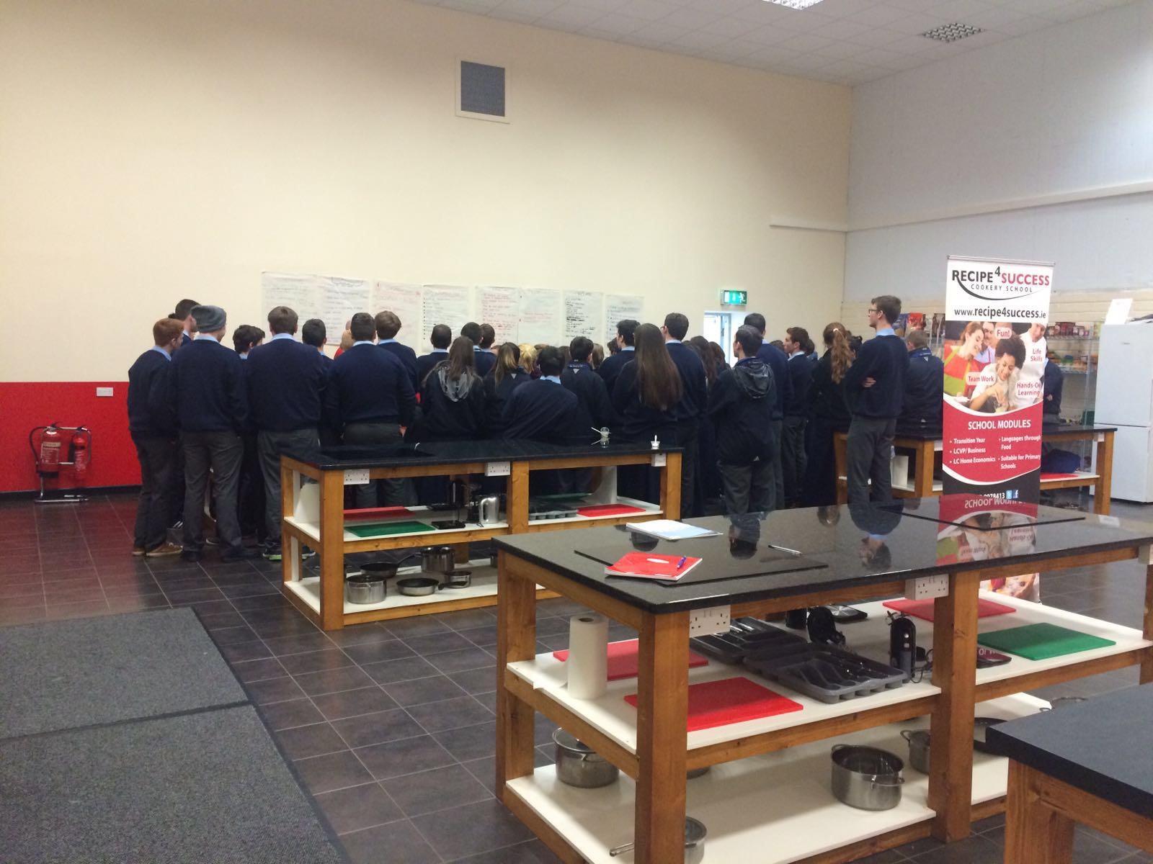
LCVP Visit

Slide 10
LCVP Subject Groupings
Vocational Subject Groupings (VSGs) 2018/2019
Specialist Groupings
1 Construction Studies; Engineering; Design and Communication Graphics; Technology - Any Two 2 Physics and Construction Studies or Engineering or Technology or Design & Communication Graphics 3 Agricultural Science and Construction Studies or Engineering or Technology or Design & Communication Graphics 4 Agricultural Science and Chemistry or Physics or Physics/Chemistry 5 Home Economics; Agricultural Science; Biology - Any Two 6 Home Economics and Art - Design Option or Craft Option 7 Accounting; Business; Economics - Any two 8 Physics and Chemistry 9 Biology and Chemistry or Physics or Physics/Chemistry 10 Biology and Agricultural Science 11 Art - Design Option or Craft Option and Design & Communication Graphics
Services Groupings
12 Engineering or Technology or Construction Studies or Design & Communication Graphics and Accounting or Business orEconomics 13 Home Economics and Accounting or Business or Economics 14 Agricultural Science and Accounting or Business or Economics 15 Art Design or Craftwork Option and Accounting or Business or Economics 16 Music and Accounting or Business or Economics

Slide 11
Junior Cycle→ Senior Cycle
Business→
  Accounting
  Economics
  Business
Science→
  Biology
  Chemistry
  Physics
  Agricultural Science
Materials Technology Wood = Woodwork→
  Construction Studies
Technical Graphics (TG)
  Design & Communication Graphics
Metalwork→
  Engineering

Slide 12

Next Steps!
Keep options open for 3rd level

Slide 13
Some Post Leaving Certificate Options
University
Institute of Technology (IT)
College of Further Education (FET Colleges)
  Also known as PLC Courses.
  Direct entry
  No points
  Interview
Apprenticeship
  Direct Application
  Possible aptitude tests/assessments
Work

Slide 14
Universities and ITs
CAO System
  Points
  Entry Requirements
    General Entry Requirements
    Specific Subjects
Notes:
Need to understand 3rd level to make informed LC subject choices

Slide 15

Points
Six best subjects
All worth the same except:
  H.L. Maths
  LCVP

Slide 16

Points
Points are allocated for the six best grades
Points must be achieved in one sitting of the Leaving Certificate
Entry to a course will be granted to those who have highest points
Colleges do not set the points rather the number of places→ supply & demand
The points reflect the results of the students and the number of places available in the college in that year

Slide 17
Subject Choice – Examined Subjects
You will take 7 subjects unless you have an exemption from one
You will choose 4 subjects as well as English, Irish and Maths
LCVP is taken an 8th subject if you are eligible for it

Slide 18
Leaving Cert Established
Core Subjects
Examined at LC (3)
  Irish
  English
  Mathematics
Non Exam
  PE
  RE including RSE
  Careers
Option Subjects (4)
  Choose from 17 Subjects
  Option form in your pack
  Total of 7 subjects examined at Leaving Certificate plus LCVP if eligible
  NOTE: History and Geography are mandatory for JC but optional for Leaving Cert

Slide 19
LCVP
What is it?
  An add on programme where you study two modules namely Enterprise Education and The world of Work. It aims to prepare young people for both.
How do I get it?
  By having the correct combination of subjects
Why is it a good idea?
  If you do any ordinary level subjects it is very useful for points
  It is common level
  It is assessed completely before the LC
  60% portfolio including items like CV, Career Investigation, Recorded Interview, visits
  40% Exam in May of LC Year

Slide 20
LCVP Subject Groupings
Vocational Subject Groupings (VSGs) 2018/2019
Specialist Groupings
1 Construction Studies; Engineering; Design and Communication Graphics; Technology - Any Two 2 Physics and Construction Studies or Engineering or Technology or Design & Communication Graphics 3 Agricultural Science and Construction Studies or Engineering or Technology or Design & Communication Graphics 4 Agricultural Science and Chemistry or Physics or Physics/Chemistry 5 Home Economics; Agricultural Science; Biology - Any Two 6 Home Economics and Art - Design Option or Craft Option 7 Accounting; Business; Economics - Any two 8 Physics and Chemistry 9 Biology and Chemistry or Physics or Physics/Chemistry 10 Biology and Agricultural Science 11 Art - Design Option or Craft Option and Design & Communication Graphics
Services Groupings
12 Engineering or Technology or Construction Studies or Design & Communication Graphics and Accounting or Business orEconomics 13 Home Economics and Accounting or Business or Economics 14 Agricultural Science and Accounting or Business or Economics 15 Art Design or Craftwork Option and Accounting or Business or Economics 16 Music and Accounting or Business or Economics

Slide 21
Junior Cycle→ Senior Cycle
Business→
  Accounting
  Economics
  Business
Science→
  Biology
  Chemistry
  Physics
  Agricultural Science
Materials Technology Wood = Woodwork→
  Construction Studies
Technical Graphics (TG)
  Design & Communication Graphics
Metalwork→
  Engineering

Slide 22
Some Post Leaving Certificate Options
University
Institute of Technology (IT)
College of Further Education (FET Colleges)
  Also known as PLC Courses.
  Direct entry
  No points
  Interview
Apprenticeship
  Direct Application
  Possible aptitude tests/assessments
Work

Slide 23
Universities and ITs
CAO System
  Points
  Entry Requirements
    General Entry Requirements
    Specific Subjects
Notes:
Need to understand 3rd level to make informed LC subject choices

Slide 24
Points
Six best subjects
All worth the same except:
  H.L. Maths
  LCVP

Slide 25
Points
Points are allocated for the six best grades
Points must be achieved in one sitting of the Leaving Certificate
Entry to a course will be granted to those who have highest points
Colleges do not set the points rather the number of places→ supply & demand
The points reflect the results of the students and the number of places available in the college in that year

Slide 26
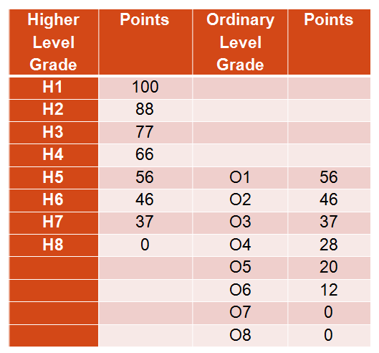
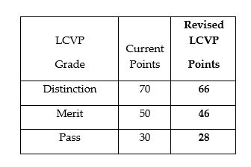
New Points System August 2017

Slide 27
Maths
25 bonus points will continue to be awarded for Higher Level Mathematics for H6 grades (40%) and above.
Foundation Level Mathematics: Universities do not award points for Foundation Level. Be very careful with Foundation Level as it is only accepted for a few courses.

Slide 28
Option Subjects
Think ahead to the next step
Keep options open for 3rd level
College entry in the Republic of Ireland = CAO System:
  Points
  Entry Requirements
    General Entry Requirements
    Specific Subjects
Notes:
Need to understand 3rd level to make informed LC subject choices

Slide 29
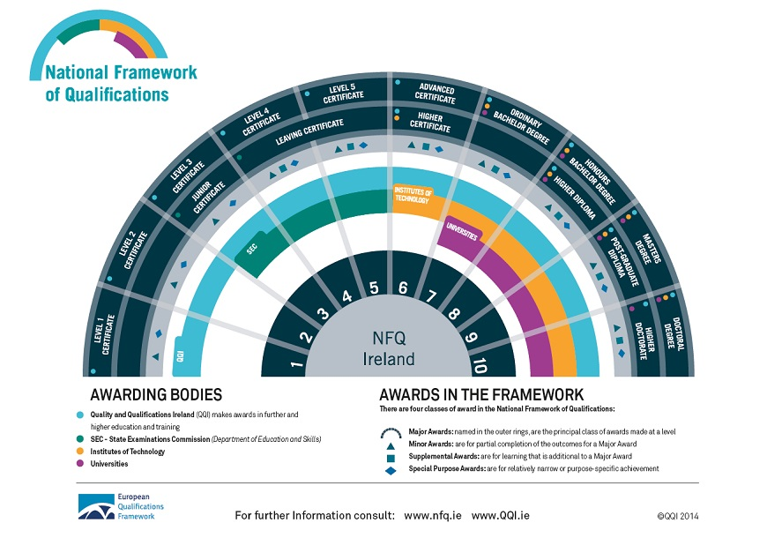
y

Slide 30
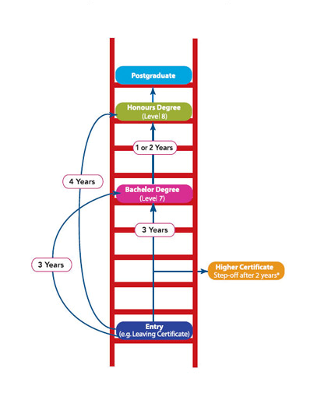
Ladder Approach
Different General Entry Requirements for each level
There is a route for everyone

Slide 31
Entry Requirements
Level 8 Courses (in most cases)
6 Subjects: 2 H5 and 4 O6/H7 grades
3 H5 and 3 O6/H7 grades
IT’s Level 6/ 7 courses (in most cases)
5 O6/H7 grades
Post Leaving Cert Courses
Pass Leaving Cert + Interview

Slide 32

General Entry Requirements
For almost all courses:
English and Maths
Be careful with Foundation Level
Think carefully about levels as this affects Entry Requirements

Slide 33

Specific Subject Requirements
It is important to realise that choosing your subject options for the Leaving Certificate is different from choosing your career.
Required subjects Vs Helpful subjects

Slide 34

Required or Helpful? Assumptions…
  For example
  you don’t have to do Engineering in the Leaving Certificate to become an engineer but it will be helpful. However Honours Maths and Physics are very helpful. (and often essential)
Notes:
Business
Science Entry requirements only one subject but two very useful

Slide 35


Science Subjects & Foreign Languages
A decision to drop all science subjects or foreign languages will have significant implications on the range of courses/careers open to you later on.

Slide 36
WHY?
If you are considering Medical, Paramedical, Nursing, Science or Engineering courses you should select a laboratory science subject or two for some courses. Having more sciences may make first year in college easier but will also close other doors.
Physics
Chemistry
Biology

Slide 37
Languages
Approximately 10% of all CAO courses require a language other than Irish and English.
Limerick colleges do not require a third language unless it is part of the course of study.
On www.qualifax.ie you can see the implications of not doing a language
Mostly arts and humanities courses require a third language. Note: Medicine, PE in UCC, Shannon College of Hotel Management, Home economics teaching, Architecture in UCD, Speech Therapy also require a language.
NUI Colleges: UCD, MU, NUIG,UCC,RCSI,SCHM,NCAD,ST. ANGELAS, MILLTOWN INSTITUTE and Institute of Public Administration.
Moral of the story→ CHECK!

Slide 38
Languages
A Pass in a European Language is required for entry to many courses in NUI colleges. The main exceptions are
    NCAD which will accept Art/DCG instead of a language
    Some Science, Nursing and Engineering courses
  UL, Trinity, DCU, DIT and all Institutes of Technology require either:
    English and Maths
    English, Maths and ANOTHER language which can be Irish
    Irish/Language Exemptions carry through if OFFICIAL exemptions
    Gardaí, Army cadetships, Primary Teaching→ exemptions do not apply

Slide 39

Basic Entry Requirements: Languages
College | Subjects Required
NUI Colleges | English, Irish, and a third Language for some courses
Trinity | English, Maths and another Language
UL | English, Maths and another language
DCU | Maths & English or Irish
I.T’s | Maths & English or Irish
Others | Vary

Slide 40
Specific Subject Requirements
Science: One or two science subjects depending on the course or university. Biology, Chemistry, Physics or Ag. Science (sometimes accept Maths or Applied Maths)
Engineering: Honours Maths for Universities (Special Maths exam)
Primary Teaching: H5 in Higher Level Irish (H4 from 2019)
Veterinary Medicine /Dietetics/Pharmacy/Dentistry: Chemistry
Medicine: HPAT + Chemistry + one science depending on location
Art: Portfolio and Art or Language or DCG
eg (NCAD)
Trinity: Paramedical/science→ 2 Science Subjects

Slide 41
Specific Subject Requirements
Nursing: Science subject
Beautician: Biology/Home Economics
Medical Sciences: 1/2 science subjects
Many of these courses also have specific grade requirements e.g. O6/H7 in 1 science for 6 year course; 5 year course H4 in Chemistry + H4 Physics or Biology medicine in RCSI etc
Important to check with Individual colleges
Notes:
RCSI physio and pharmacy: HB3 ph.ch.bi.ph/ch or ma
Med: 5 yrs = hb3 ch+ ph or bi
6 yrs od3 one science
UCD medicine one science
Tcd
2hc for science. Pharmacy hc3 ch + 1hc other sc
Physio 2hc
Rad th /ot/ 1hc
Pharmacy:

Slide 42


And …
Do not give up subjects you love!

Slide 43





CHOOSING SUBJECTS
  Choose subjects YOU:
  Like
  Have achieved well in
  Need for your future
  Are prepared to work at
  Link talents to subjects
  Talk to teachers, siblings, neighbours, people on the bus
  Look at senior cycle text books
  Choose a good mix of subjects to keep college and career options open

Slide 44




Consider the following factors when choosing your subjects:
ABILITY - choose subjects in which you are likely to get good grades.
INTEREST - Choose subjects that you are genuinely interested in as you are much more likely to study those subjects and do well in them.
CAREER - In addition to the core subjects (Irish, English, Maths) there are other subjects that are essential for some courses and careers.

Slide 45
Making a Wise Choice
What subject am I most interested in?
What subject am I likely to be best at?
What subjects will I need?
Balanced choice of subjects

Slide 46
Career Decisions?
Knowing about
Myself
Abilities
Personality
Education
Achievements
Experience of
\work
Interests
Notes:
46

Slide 47
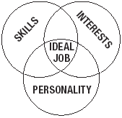
Choosing a Career
Things you like doing
Skills/abilities/aptitude
What you’re good at naturally
What kind of person am I? Do I prefer working on my own/with people?

Slide 48

Not sure? Safe option
Irish
English
Maths
Language
At least one Science subject

Slide 49
Resources
www.curriculumonline.ie Syllabus for LC Subjects
www.examinations.ie Look at past exam papers
www.qualifax.ie Check entry requirements
www.careersportal.ie Read about all LC Subjects
College websites www.ul.ie www.lit.ie www.mic.ul.ie
College Prospectuses
Guidance Counsellor→ make an appointment
Teachers
Senior Cycle Textbooks

Slide 50
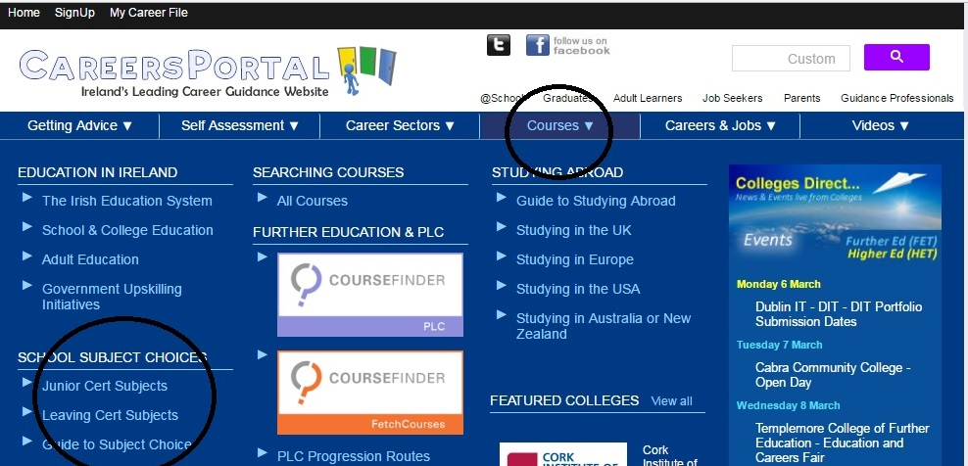
www.careersportal.ie

Slide 51

Language Entry Requirements for Third Level
Two languages (English + One other) required for the following colleges:
  Trinity College
  Dublin Institute of Technology
  Dublin City University -
  University of Limerick
  you can use a Pass in Irish of a European language – unless it is required for a particular course

Slide 52
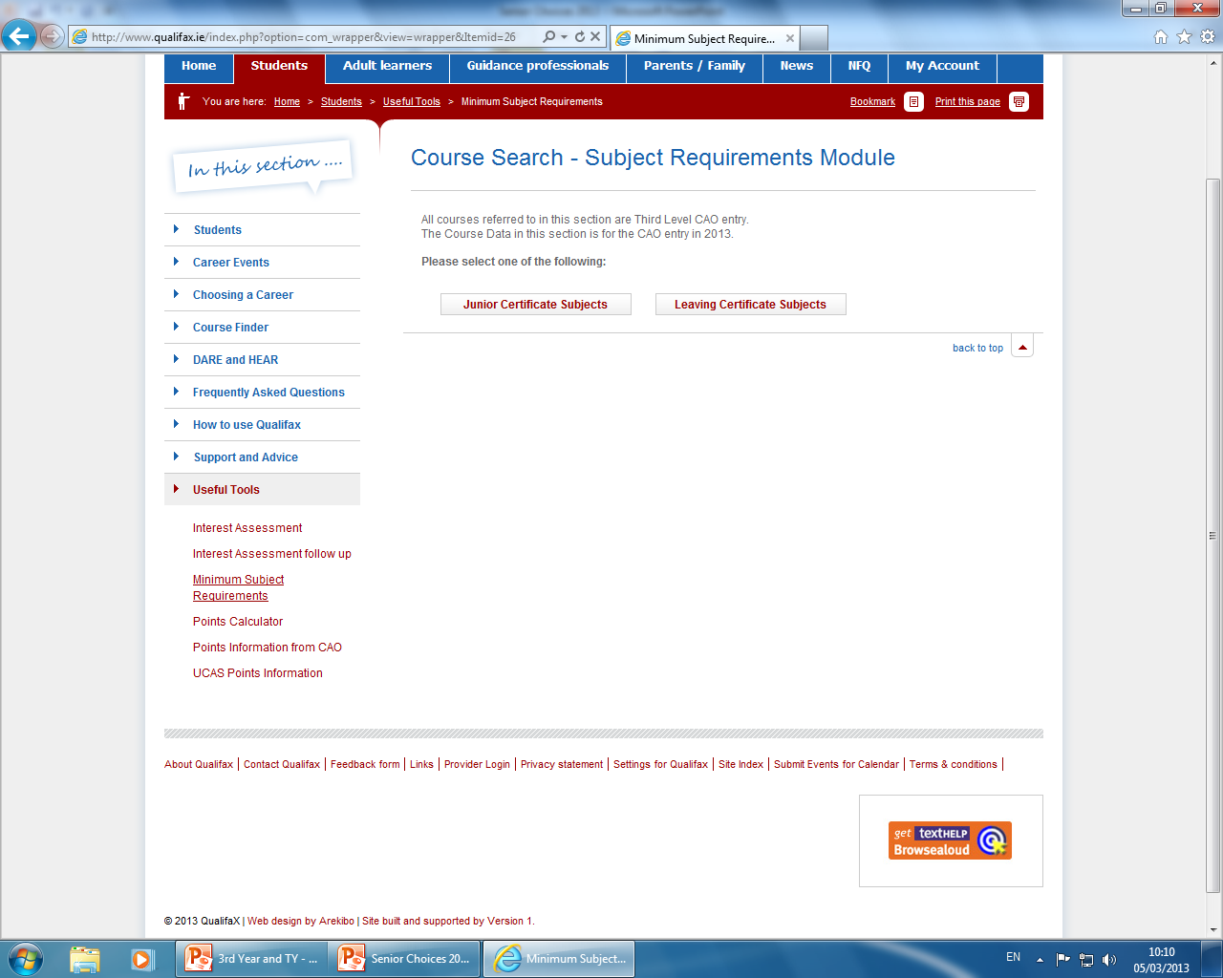
Language Entry Requirements for Third Level
Cadetships in the Army, Army equitation, Air Corps and Naval Service.
  3 HC3 and 3OD3
  Irish +English + European Language
For the Gardaí - two languages are required
A European Language is not required for entry to the Institutes of Technology, unless it is part of the area of study

Slide 53
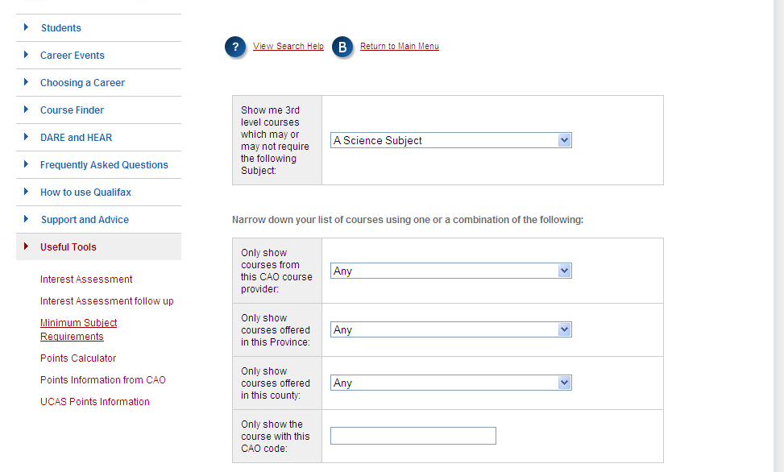

Subject Requirements
Science courses: Science Subject
Engineering: Honours Maths

Slide 54
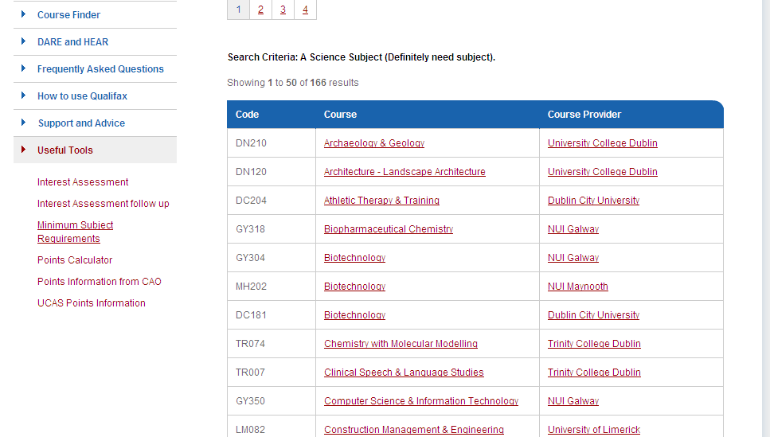

Slide 55
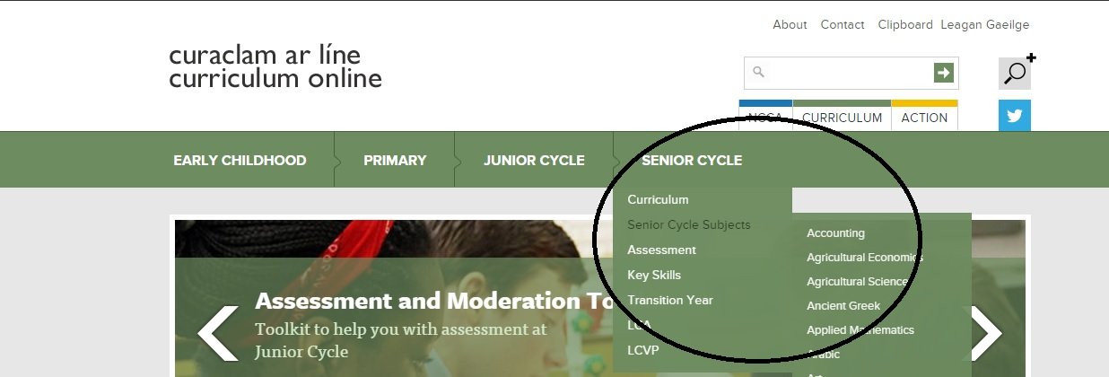
www.curriculumonline.ie

Slide 56
Research…
CAO App www.cao.ie
Qualifax/Student/useful tools/minimum entry requirements/Leaving Cert Subjects→ Choose a subject and check the implications of not choosing
Qualifax/Student/coursefinder/higher education CAO/Keyword + Search
  Main sections of interest:
  LC Entry Requirements
  Course Content
  Subjects taught
  Careers or further progression

Slide 57

Follow Ms.Daly on Instagram
Twitter @stannescck

Slide 58
Final words….
It’s important not to lock yourself out of a course you want to study by not choosing a required subject
Do your research
Different colleges can have different requirements for the same course

Slide 59
Note the following:
Numbers for particular classes may be limited e.g practical subjects 20/24 max
In so far as possible students will be given their subject choice
It is very important when choosing the subjects to put them in order of preference
You must complete form from 1-6
Do not choose subjects that you have not sat for your Junior Cert unless you have spoken to the relevant teacher AND had them sign on the form that they are happy to take you on.

Slide 60
What next?
Complete the option form and return to the office by Friday March 16th
You must complete 1-6
Any extra information please write on the front of the form
Be sure to complete the section listing the four JC Subject Options
Please complete the phone number section so we can contact you if we need to

Slide 61
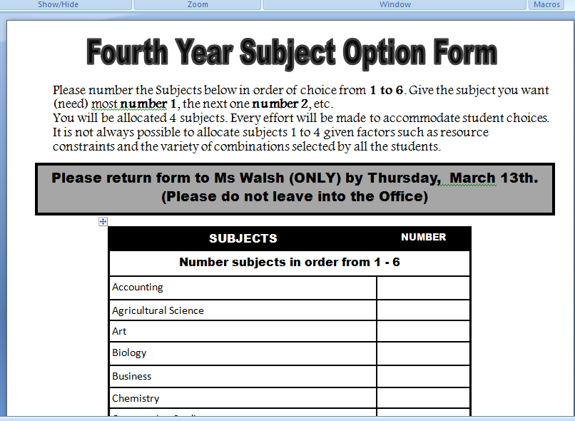
The Form

Slide 62
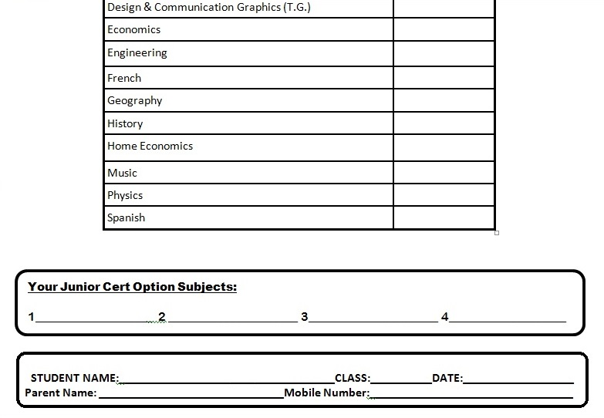
The form

Slide 63
Reminder
All information is subject to change and it is the student and parent responsibility to check information regarding careers online directly with the institutions concerned.

Slide 64

What not to do!

Slide 65

What I hope you will all do!

Slide 66
Guidance Counsellor
061 620087
Karen.starr@lcetb.ie
Guidance Counsellor
juliefoconnor@gmail.com
061 620089

Slide 67


Slide 68
Transition Year Programme
The Transition Year (TY) is a one-year programme designed to act as a bridge between the Junior Certificate and Leaving Certificate programmes.
Each school designs its own Transition Year programme, within set guidelines, to suit the needs and interests of its students.
The school promotes the personal, social, vocational and educational development of students.

Slide 69
Transition Year Programme
Benefits
ESRI report: TY students get Higher points average in LC
Informed choices: better career choice
Broaden skills set
Experience
Teamwork
Concerns
Not for everyone
Not ‘Year 1’ of a three year Leaving Cert
A lot of the onus on student participation
Reduced homework
Different base classes
Will they settle back into LC?

Slide 70

Subjects usually studied for the entire year
Mathematics
English
Gaeilge
Mini-Company
Modern European Language (Spanish/French)
PE
Religion
YSI (Young Social Innovators)

Slide 71

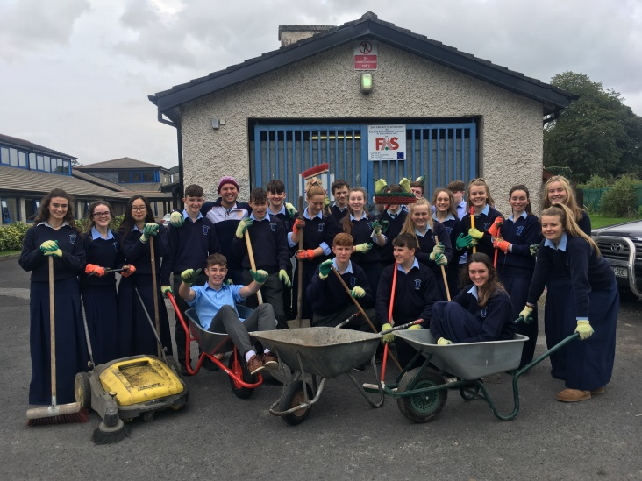
Modules
Vary slightly from year to year

Slide 72
Typical Transition Year Modules
Accountancy/Money Management
Art & Design
Book Club
Careers
Chess
Community Outreach
International Cookery
Current Affairs
Driver Theory
Engineering
Environmental Awareness/Project Work
European Studies/Geography
Film Studies
First Aid
Health and Safety
History
Information Technology
Languages
Web design
Music
Salsa
Science
Solid works
Speech and Drama
Toastmasters
Woodwork/craft
Project work
Vary slightly from year to year depending on number of class groups but typically include many of the above

Slide 73
Sample Activities
Sailing, Horse riding, tennis
Outdoor pursuits centre visits
Build a Bank
Fresh Film Festival
Enterprise competitions & trade fairs
First aid
Car/Road safety demonstration
Paintballing
Young Social Innovators
Gaisce
Community Work/ Charity Work/Fundraising
Student Life Summit
Sports Leader Award
Coaching Rowing Cert
Film events
School musical/Concert/Talent show
Workshops/Visiting Speakers
SOAR foundation Peer Support Workshop
Wheelchair basketball
Yoga & Martial Arts
International Prayer Day
SEINN Church Music Festival
International Women’s Day
Introduction to softball
School Digital Champion
Careers Talks/Open days
Irish Technology Leaders Group competition
iWish woman in STEM event
And many, many more…

Slide 74

Transition Year Programme
Assessment
Student assessments are carried out on an ongoing basis:
  Group work, presentations, written exams, projects etc
  Participation in class, project work, social work, group work, work experience etc.
  Students are awarded a Certificate for Transition year with either a Pass, Merit or Distinction

Slide 75

Transition Year Programme
Application Process.
Closing Date 16/03/2018

Slide 76
Criteria for selection into Transition Year may include the following:
Satisfactory completion of the application form including deposit by specified date
Have completed third year
Have a proven commitment to good behaviour, hard work, attendance, punctuality and study
Be committed to applying him/herself to Transition Year and to what it has to offer (e.g. to co-operate and participate in all events)

Slide 77
Expectations
Expectations
Transition year in St. Anne’s is an exciting but demanding year. You will get out of TY what you put into it.
Students will be presented with opportunities but we expect students to volunteer for the many projects and opportunities available which can take place both during and outside school time.
We expect students to be in classes with and work with different people to develop their team work and social skills.
We expect students to continue to maintain high standards of academic work and be responsible for their own learning.
We provide the opportunity for students to engage in a different style of learning and different forms of assignments and homework.
Time for reflection on their own learning and beginning to take responsibility for it.

Slide 78
TY FEES
TY FEES
A deposit of €100 (either cash or cheque payable to LCETB) with the application
AND
Either a single payment of €350 OR €150 in April, €100 in May and €100 in June 2018.
These payments preferably should be made online on our Way2Pay System. Click on the Parent Tab on our website killaloecc.ie for more details. Cash or cheques payable to LCETB are also acceptable.
All fees must be paid by 15th June 2018.

Slide 79
FEES
The TY fee will include most costs but there may be some additional costs which might arise throughout the year.
Non-payment of the full fee will lead to your child being withdrawn from the TY programme.

Slide 80
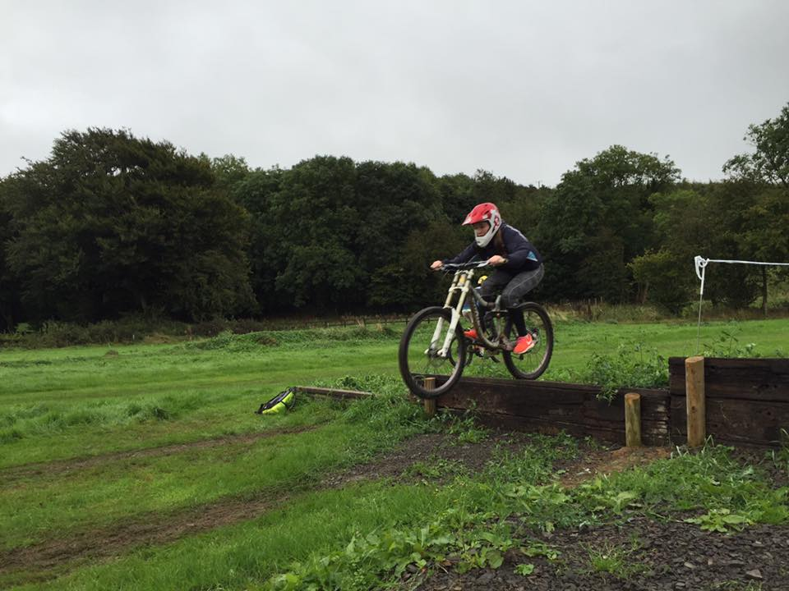
Transition Year Programme
Be Open Minded
Role
of T.Y. Student
Have-a-go
Positive Attitude
Respect Others

Slide 81

Transition Year Programme
Application Form
Role
of Parents
Encourage
Support
Communicate

Slide 82
Transition Year at St. Anne’s
A flavour of TY

Slide 83
What this years students say
Good to help you mature
Become more independent
Get to do more stuff on your own
Have to decide to do things and get involved
Not a doss!
Have to put yourself out there
Our first term was full of projects

Slide 84
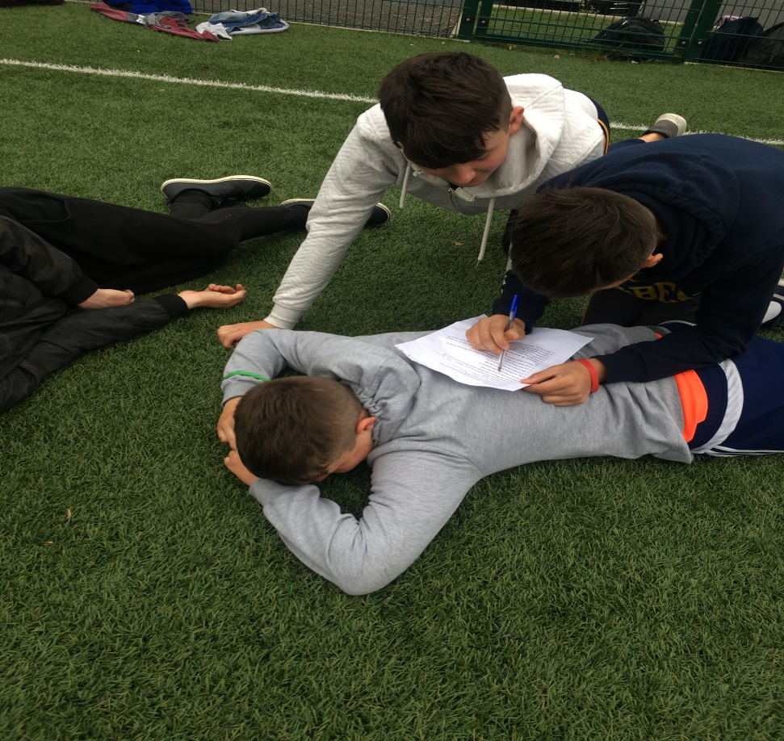
Cooperation
Working in different ways
With different people

Slide 85


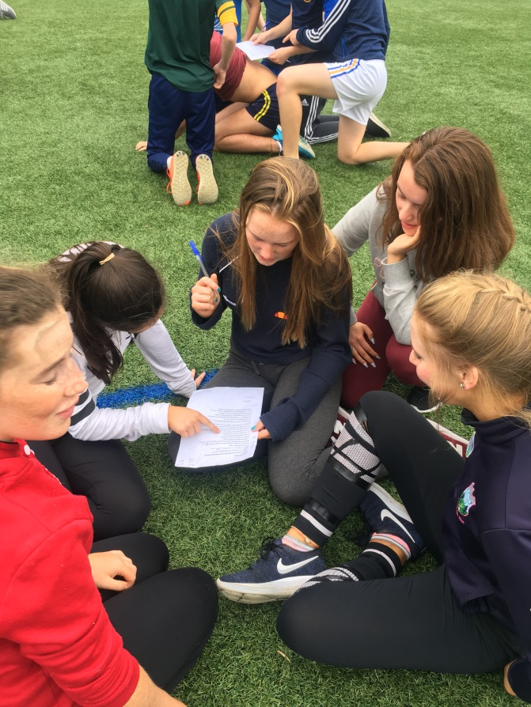
TEAM WORK

Slide 86
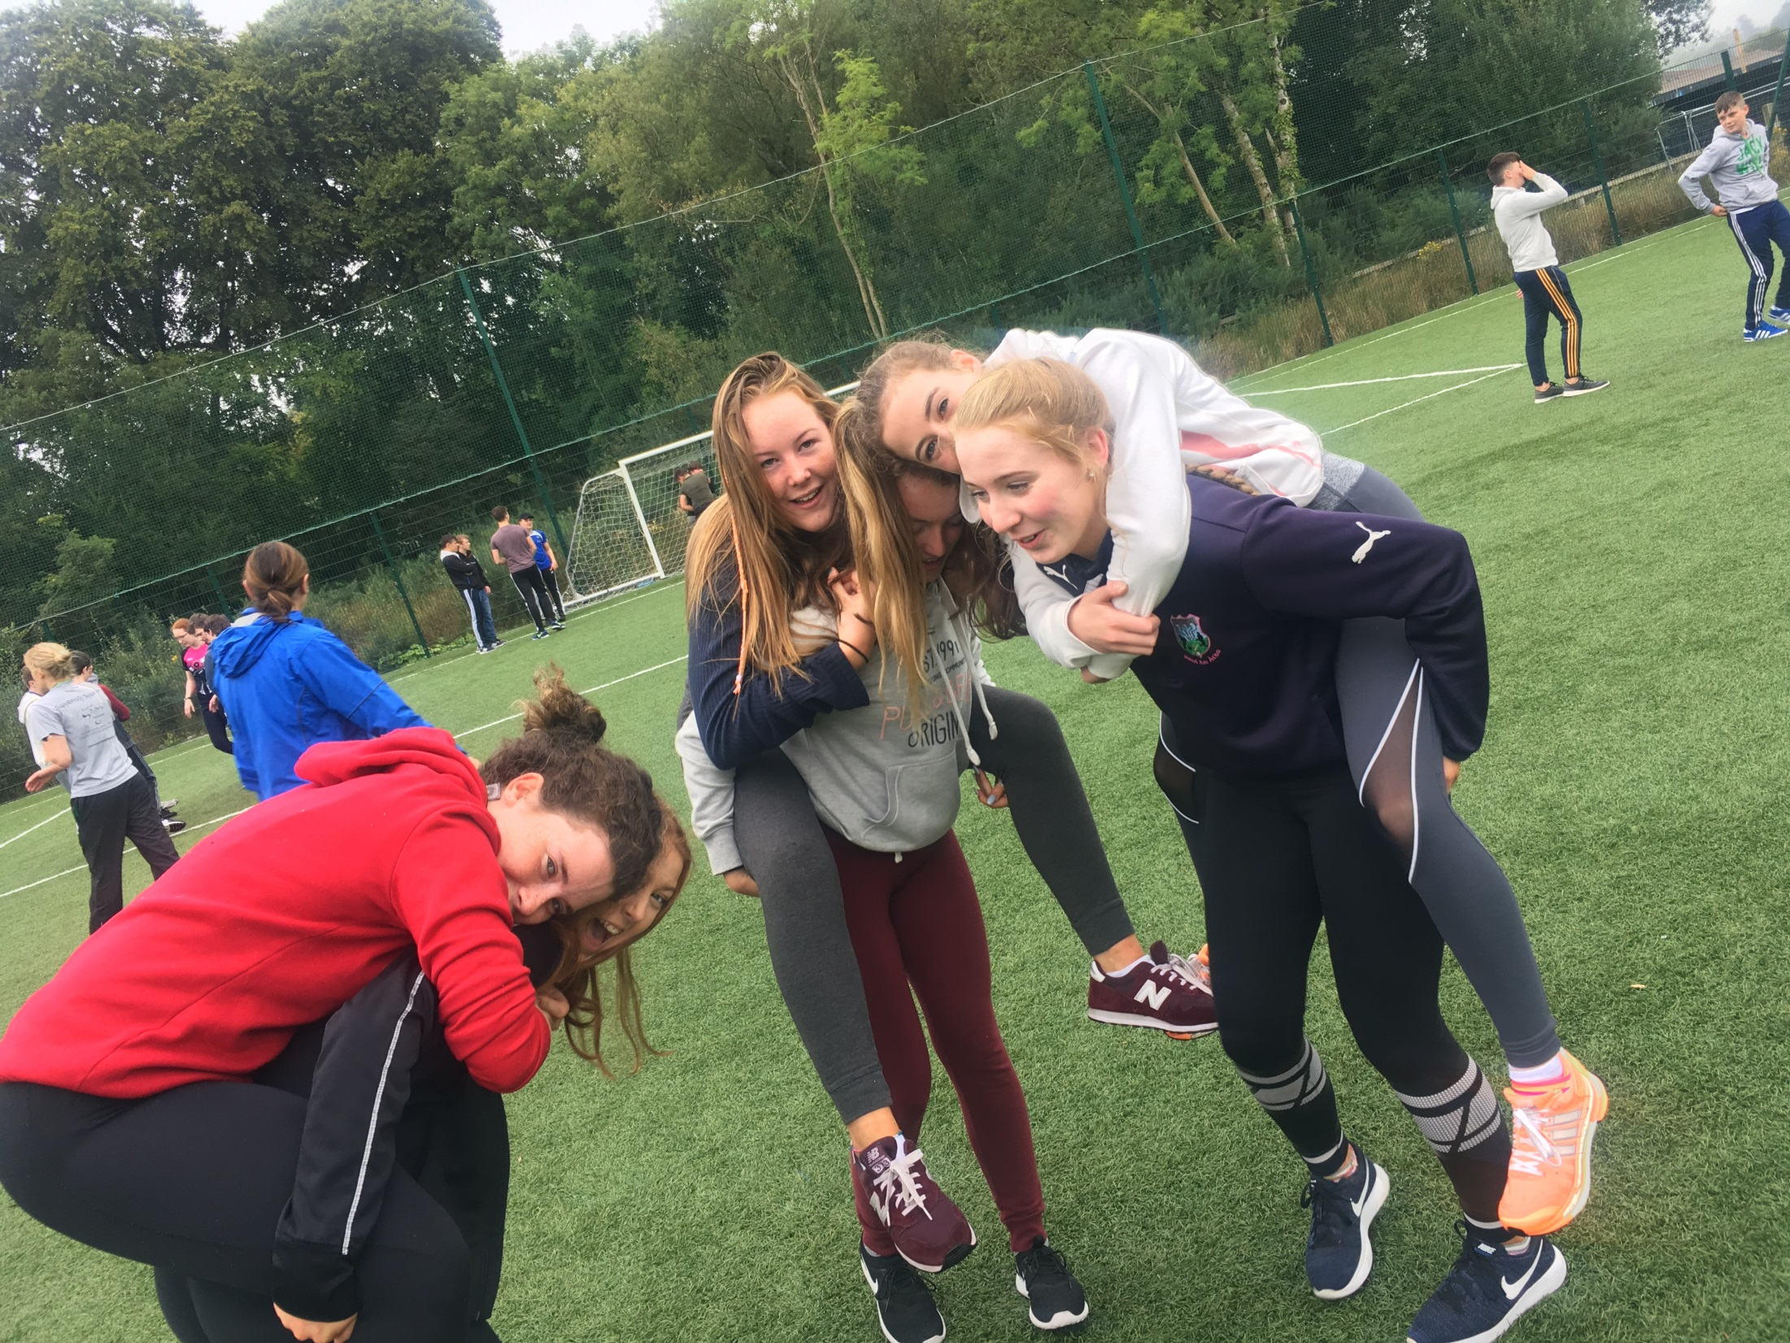

Slide 87
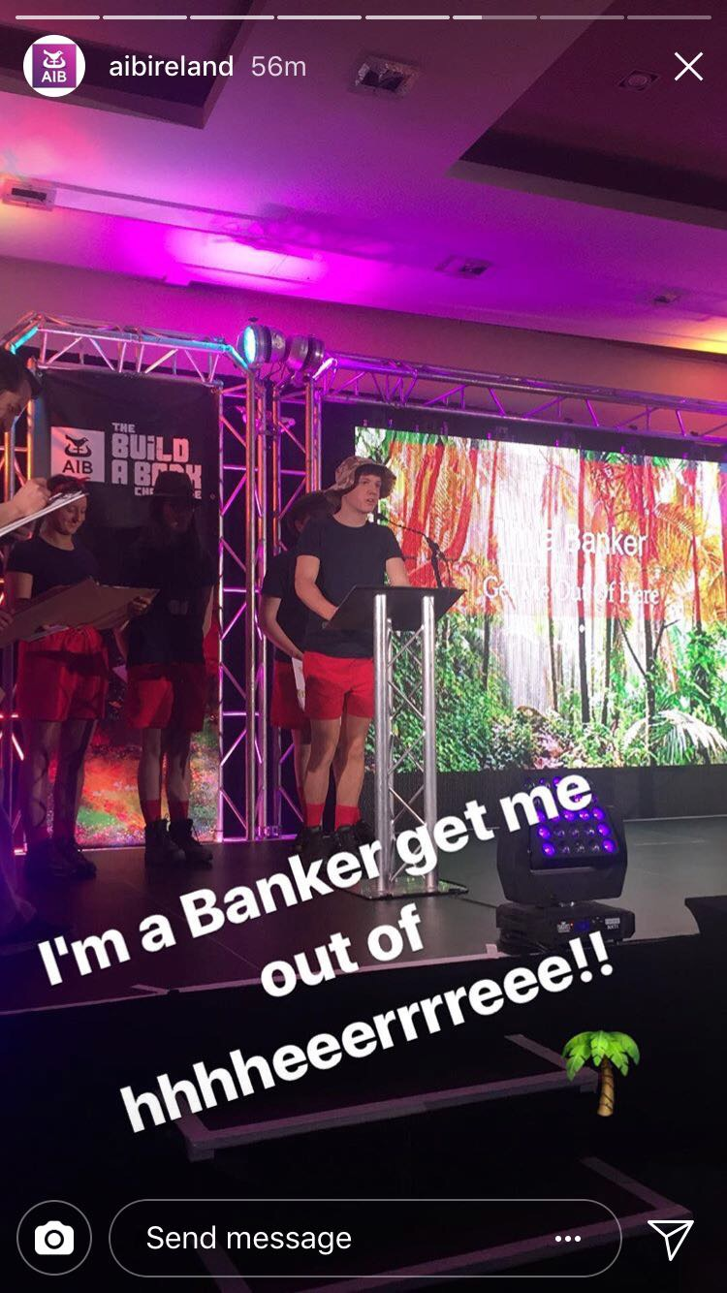
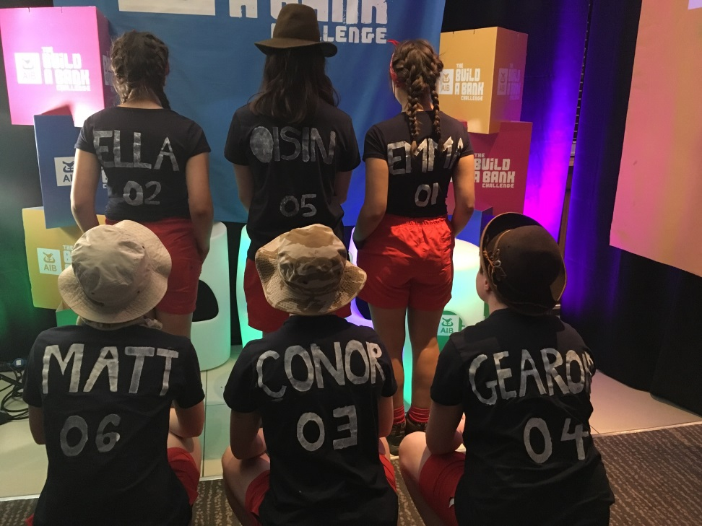
Comfort Zone

Slide 88

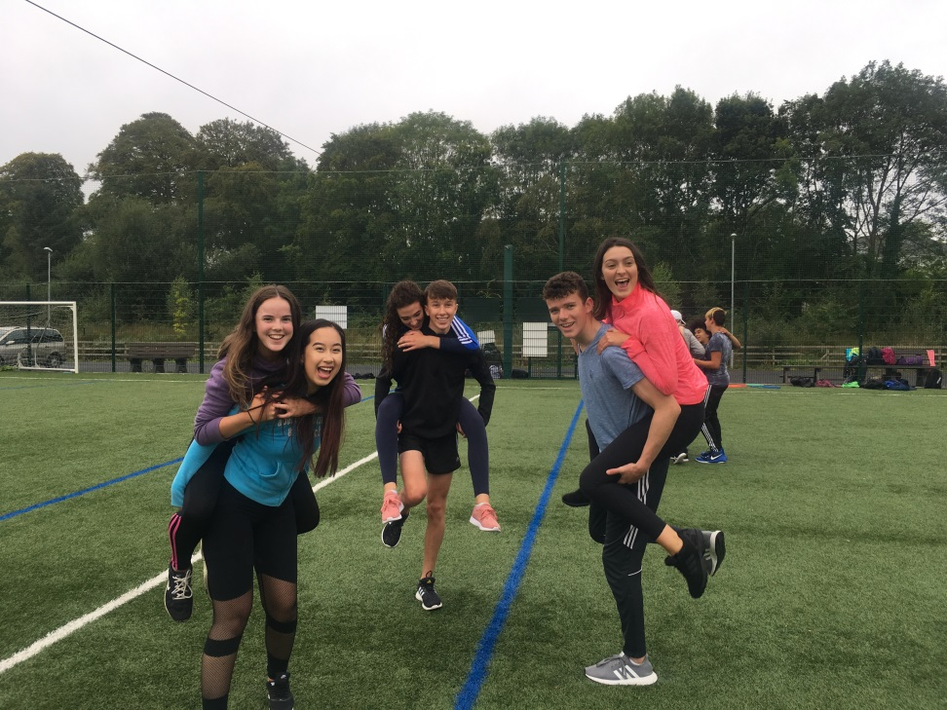
Variety

Slide 89
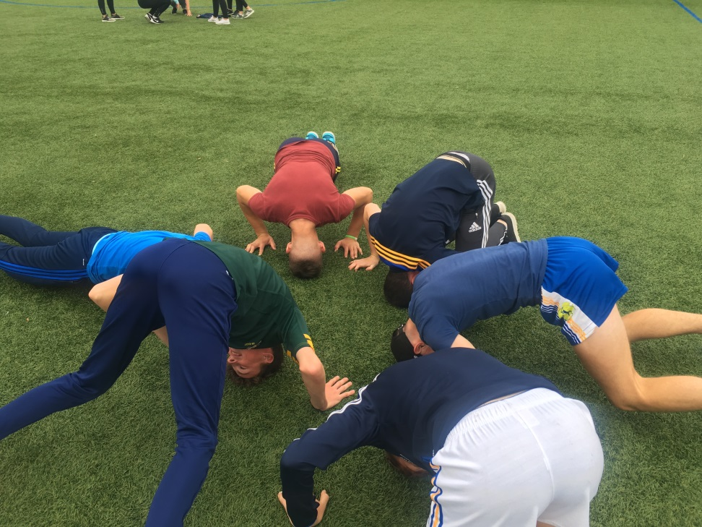
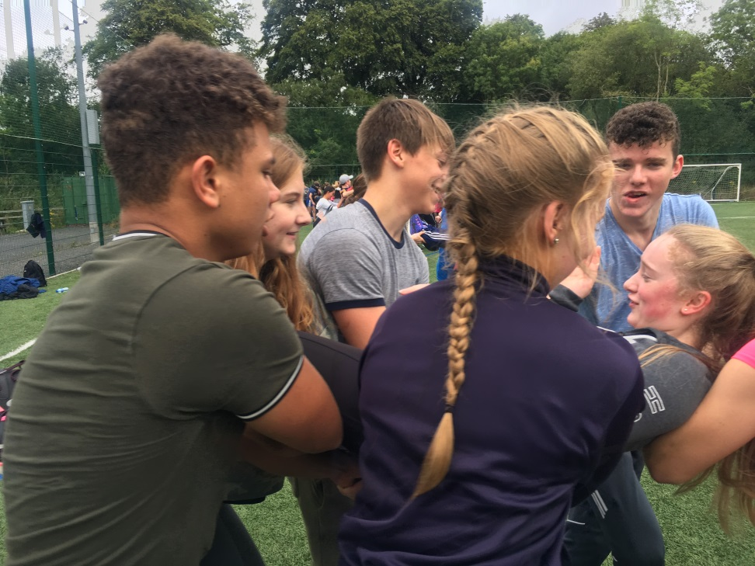
Try different things

Slide 90
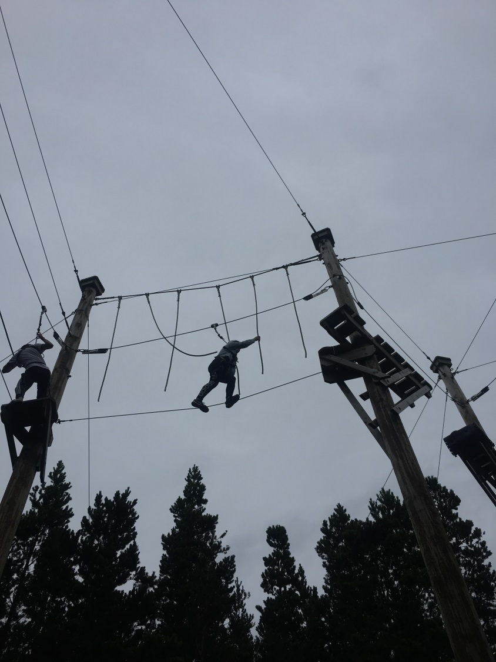
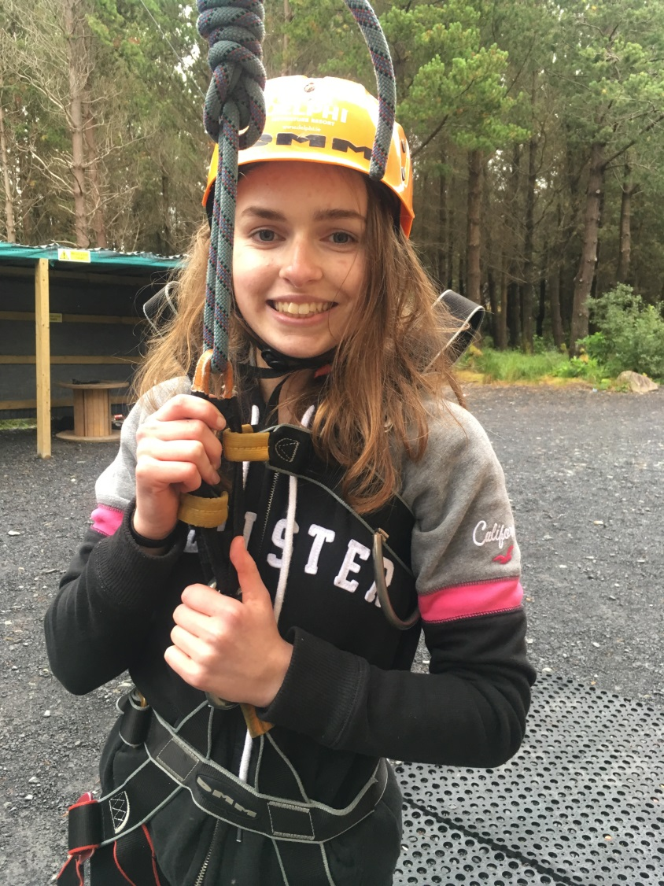
Conquering fears

Slide 91
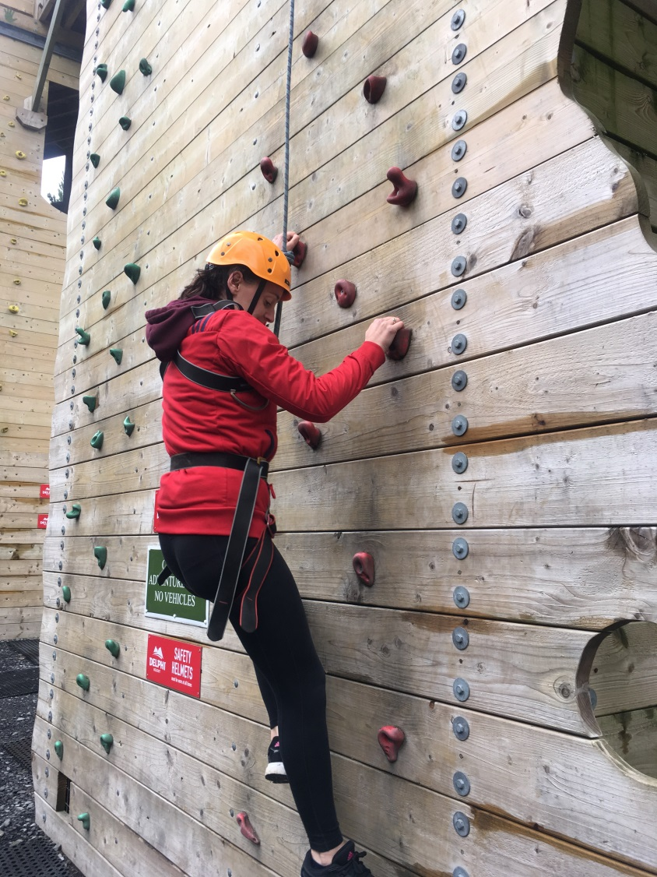
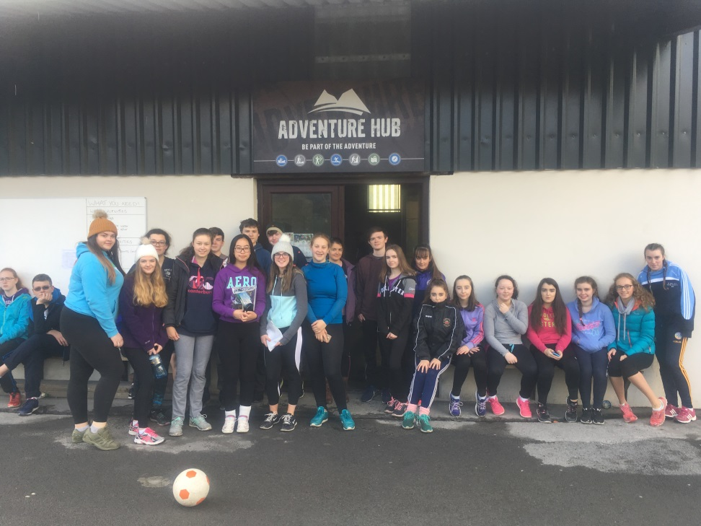
Getting to know your teachers in a different way

Slide 92
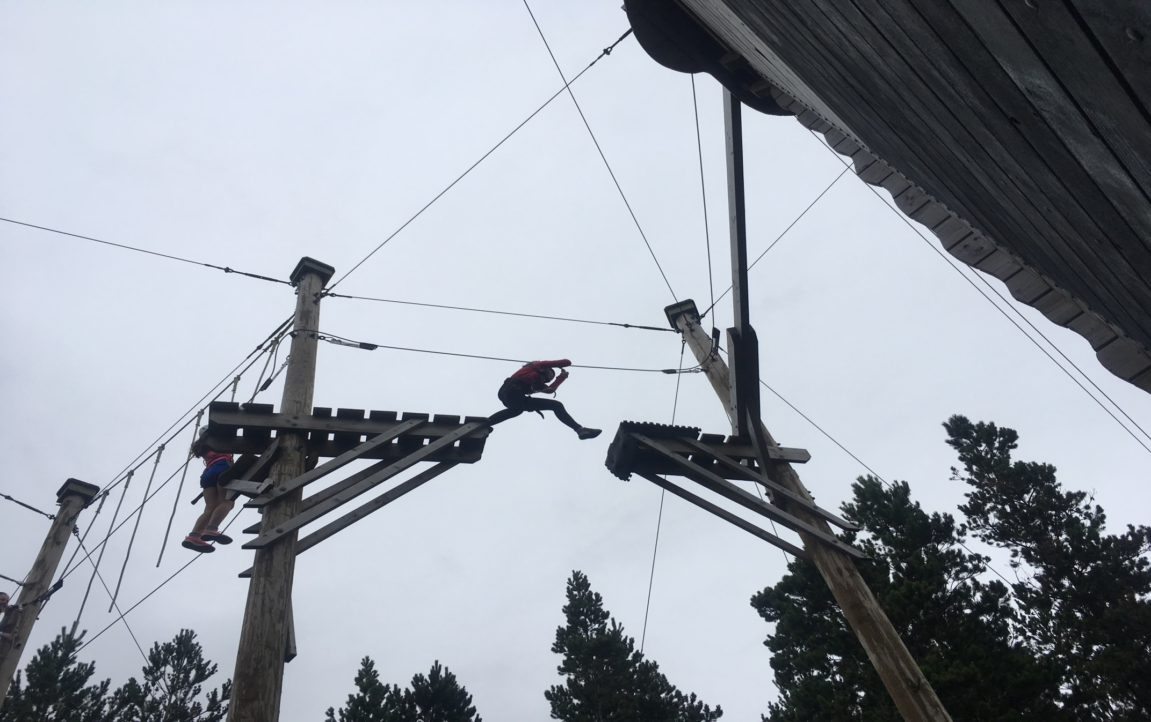
TY….A leap of faith

Slide 93
Questions
.
Queries:
Contact
Fiona Daly
061 376257
Fiona.daly@lcetb.ie

