Slide 1
INFORMATION EVENING
MONDAY 7TH MARCH 2016
St. Anne's community college
SENIOR CHOICES

Slide 2

Exhibition opens Thursday in the Hunt Museum
(see our website for more details: www.killaloecc.ie

Slide 3
OPTIONS
Ty
OR
Leaving Cert

Slide 4
Outline
4th Year Information
Questions & Answers
TY information
Questions & Answers

Slide 5
What we’re doing….
3rd Year briefings on subjects from staff
Presentations from Guidance Counsellor
Websites to research
Parents Information evening
Appointments as required
Presentation will be available to download from www.killaloecc.ie under the ‘Parents’ tab

Slide 6

Choices

Slide 7
Subject Choice – Examined Subjects
You will take 7 subjects unless you have an exemption from one
You will choose 4 subjects as well as English, Irish and Maths
LCVP is taken an 8th subject if you are eligible for it

Slide 8
Leaving Cert Established
Core Subjects
Examined at LC (3)
  Irish
  English
  Mathematics
Non Exam
  PE
  RE including RSE
  Careers
Option Subjects (4)
  Choose from 17 Subjects
  Option form in your pack
  Total of 7 subjects examined at Leaving Certificate plus LCVP if eligible
  NOTE: History and Geography are mandatory for JC but optional for Leaving Cert

Slide 9
LCVP
What is it?
  An add on programme where you study two modules namely Enterprise Education and The world of Work. It aims to prepare young people for both.
How do I get it?
  By having the correct combination of subjects
Why is it a good idea?
  If you do any ordinary level subjects it is very useful for points
  It is common level
  It is assessed completely before the LC
  60% portfolio including items like CV, Career Investigation, Recorded Interview, visits
  40% Exam in May of LC Year

Slide 10
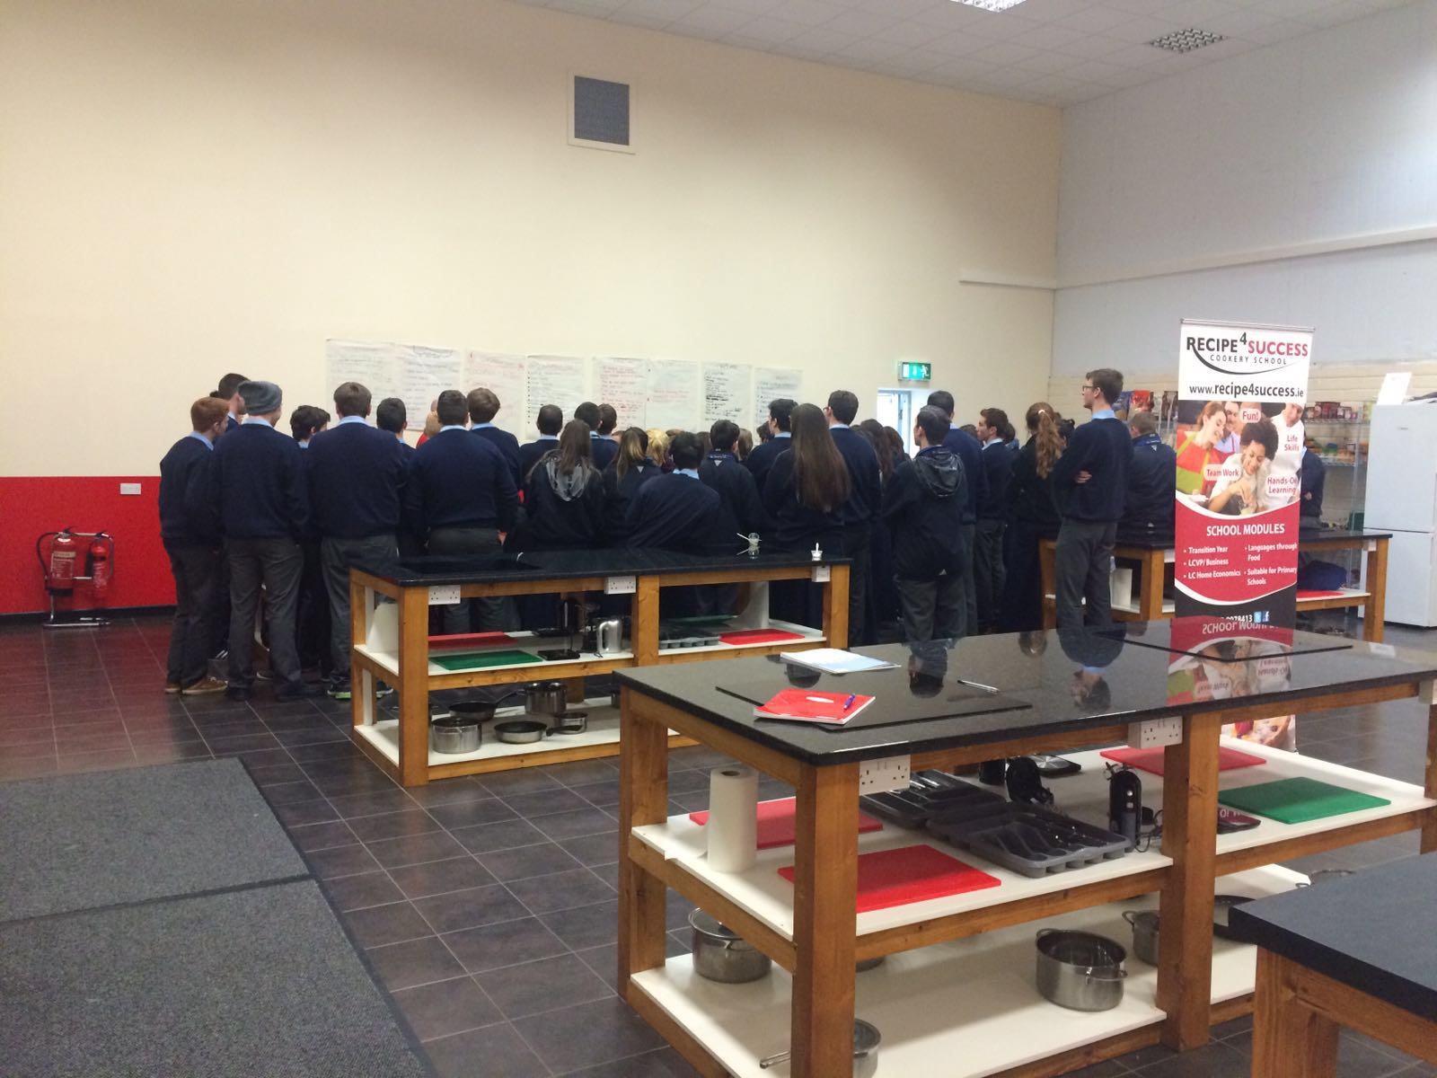
LCVP Visit

Slide 11
LCVP Subject Groupings
Vocational Subject Groupings (VSGs) 2015/2016
Specialist Groupings
1 Construction Studies; Engineering; Design and Communication Graphics; Technology - Any Two 2 Physics and Construction Studies or Engineering or Technology or Design & Communication Graphics 3 Agricultural Science and Construction Studies or Engineering or Technology or Design & Communication Graphics 4 Agricultural Science and Chemistry or Physics or Physics/Chemistry 5 Home Economics; Agricultural Science; Biology - Any Two 6 Home Economics and Art - Design Option or Craft Option 7 Accounting; Business; Economics - Any two 8 Physics and Chemistry 9 Biology and Chemistry or Physics or Physics/Chemistry 10 Biology and Agricultural Science 11 Art - Design Option or Craft Option and Design & Communication Graphics
Services Groupings
12 Engineering or Technology or Construction Studies or Design & Communication Graphics and Accounting or Business orEconomics 13 Home Economics and Accounting or Business or Economics 14 Agricultural Science and Accounting or Business or Economics 15 Art Design or Craftwork Option and Accounting or Business or Economics 16 Music and Accounting or Business or Economics

Slide 12
Junior Cycle→ Senior Cycle
Business→
  Accounting
  Economics
  Business
Science→
  Biology
  Chemistry
  Physics
  Agricultural Science
Materials Technology Wood = Woodwork→
  Construction Studies
Technical Graphics (TG)
  Design & Communication Graphics
Metalwork→
  Engineering

Slide 13

Next Steps!

Slide 14
Option Subjects
Think ahead to the next step
Keep options open for 3rd level
College entry in the Republic of Ireland = CAO System:
  Points
  Entry Requirements
    General Entry Requirements
    Specific Subjects
Notes:
Need to understand 3rd level to make informed LC subject choices

Slide 15

Points
Points are allocated for the six best grades
Grades must be achieved in one sitting of the Leaving Certificate
Entry to a course will be granted to those who have highest points
Colleges do not set the points
The points reflect the results of the students and the number of places available in the college in that year

Slide 16
New Grading System 2017
.
LCVP Common Level
NewGrades | % Marks
H1 / O1 | 90-100
H2 / O2 | 80<90
H3 / O3 | 70<80
H4 / O4 | 60<70
H5 / O5 | 50<60
H6 / O6 | 40<50
H7 / O7 | 30<40
H8/ O8 | 0<30
Grade | Per cent
Distinction Merit Pass | 80% -100% 65% – 79% 50% – 64%

Slide 17
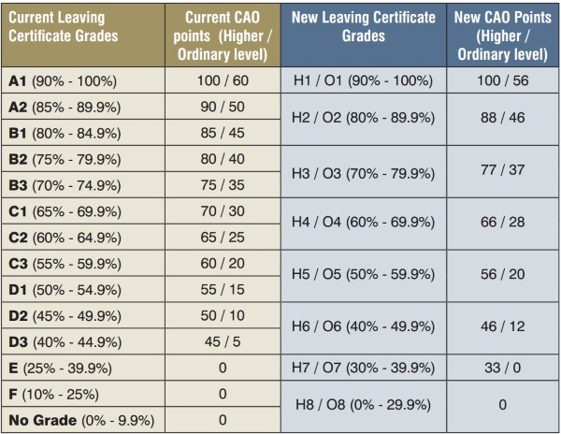
New Points System

Slide 18
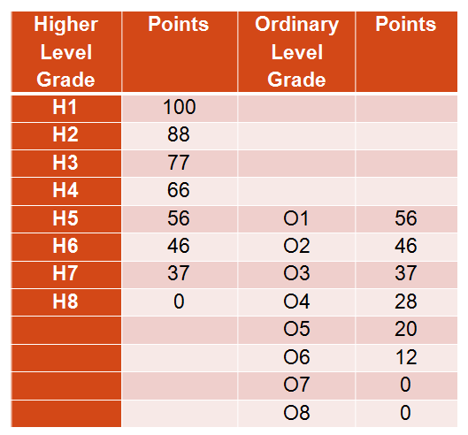
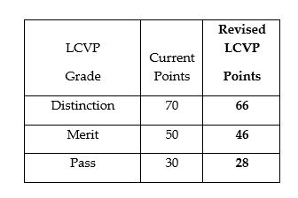
New Points System August 2017

Slide 19
Maths
25 bonus points will continue to be awarded for Higher Level Mathematics for H6 grades (40%) and above.
Foundation Level Mathematics: Universities do not award points for Foundation Level, the IoTs are currently considering a conversion for 2017.

Slide 20

Points
Six best subjects
All worth the same except:
  H.L. Maths
  LCVP

Slide 21
Option Subjects
Think ahead to the next step
Keep options open for 3rd level
College entry in the Republic of Ireland = CAO System:
  Points
  Entry Requirements
    General Entry Requirements
    Specific Subjects
Notes:
Need to understand 3rd level to make informed LC subject choices

Slide 22
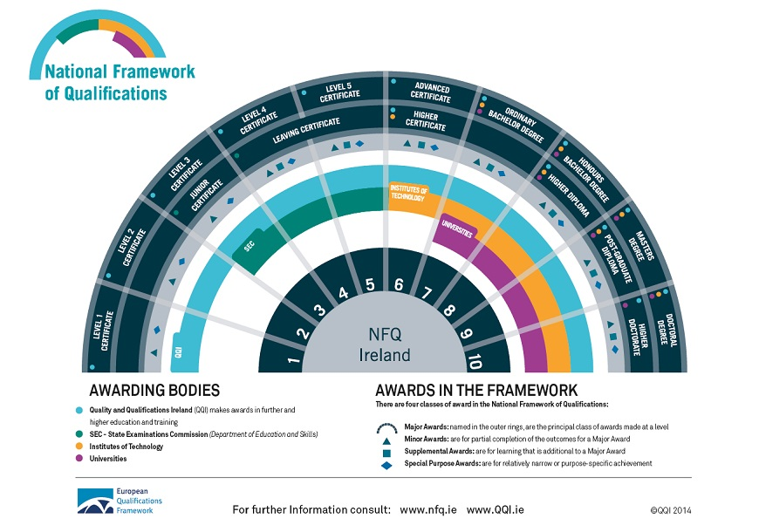
y

Slide 23
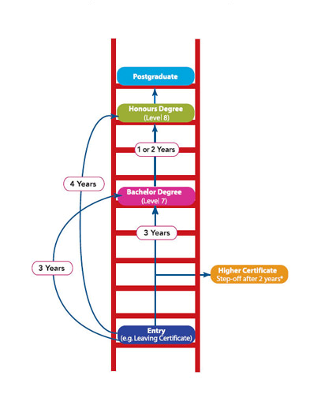
Ladder Approach
Different General Entry Requirements for each level
There is a route for everyone

Slide 24
Entry Requirements
Level 8 Courses
6 Subjects: 2HC3 + 4 OD3→ 2 H5 and 4 O6/H7 grades
3HC3 + 3OD3→ 3 H5 and 3 O6/H7 grades
IT’s Level 6/ 7 courses
5OD3 → 5 O6/H7 grades
Post Leaving Cert Courses
Pass Leaving Cert + Interview

Slide 25

General Entry Requirements
For almost all courses:
English and Maths
Be careful with Foundation Level
Think carefully about levels as this affects Entry Requirements

Slide 26

Specific Subject Requirements
It is important to realise that choosing your subject options for the Leaving Certificate is different from choosing your career.
Required subjects Vs Helpful subjects

Slide 27

Required or Helpful? Assumptions…
  For example
  you don’t have to do Engineering in the Leaving Certificate to become an engineer but it will be helpful. However Honours Maths and Physics are very helpful. (and often essential)
Notes:
Business
Science Entry requirements only one subject but two very useful

Slide 28


Science Subjects & Foreign Languages
A decision to drop all science subjects or foreign languages will have significant implications on the range of courses/careers open to you later on.

Slide 29
WHY?
If you are considering Medical, Paramedical, Nursing, Science or Engineering courses you should select a laboratory science subject or two for some courses
Physics
Chemistry
Biology

Slide 30
Languages
Approximately 10% of all CAO courses require a language other than Irish and English.
Limerick colleges do not require a third language unless it is part of the course of study.
On www.qualifax.ie you can see the implications of not doing a language
Mostly arts and humanities courses require a third language. Note: Medicine, PE in UCC, Shannon College of Hotel Management, Home economics teaching, Architecture in UCD, Speech Therapy also require a language.
NUI Colleges: UCD, MU, NUIG,UCC,RCSI,SCHM,NCAD,ST. ANGELAS, MILLTOWN INSTITUTE, Institute of Public Administration, Uversity.
Moral of the story→ CHECK!

Slide 31
Do I need a foreign language?
UCC, NUI Galway, UCD, Maynooth University and the Royal College of Surgeons and other NUI Colleges require a pass (OD3)in a third language for many of their courses.
Entry to the Cadetships in the Defence Forces requires a third Language.
Gardaí: Must have a proven proficiency in two languages; one of which must be Irish or English.
NCAD require a third language or Art

Slide 32
Languages
A Pass in a European Language is required for entry to many courses in NUI colleges. The main exceptions are
    NCAD which will accept Art instead of a language
    Some Science, Nursing and Engineering courses
  UL, Trinity, DCU, DIT and all Institutes of Technology require either:
    English and Maths
    English, Maths and ANOTHER language which can be Irish
    Irish Exemptions carry through if OFFICIAL exemptions
    Gardaí, Army cadetships, Primary Teaching→ exemptions do not apply

Slide 33

Basic Entry Requirements: Languages
College | Subjects Required
NUI Colleges | English, Irish, and a third Language for some courses
Trinity | English, Maths and another Language
UL | English, Maths and another language
DCU | Maths & English or Irish
I.T’s | Maths & English or Irish
Others | Vary

Slide 34
Specific Subject Requirements
Science: One or two science subjects depending on the course or university. Biology, Chemistry, Physics or Ag. Science (sometimes accept Maths or Applied Maths)
Engineering: Honours Maths for Universities (Special Maths exam)
Primary Teaching: C in Higher Level Irish
Veterinary Medicine /Dietetics/Pharmacy/Dentistry: Chemistry
Medicine: HPAT + Chemistry + one science depending on location
Art: Portfolio and Art or Language or soon DCG
Trinity: Paramedical/science→ 2 Science Subjects

Slide 35
Specific Subject Requirements
Nursing: Science subject
Beautician: Biology
Medical Sciences: 1/2 science subjects
Many of these courses also have specific grade requirements e.g. HB3 etc
Notes:
RCSI physio and pharmacy: HB3 ph.ch.bi.ph/ch or ma
Med: 5 yrs = hb3 ch+ ph or bi
6 yrs od3 one science
UCD medicine one science
Tcd
2hc for science. Pharmacy hc3 ch + 1hc other sc
Physio 2hc
Rad th /ot/ 1hc
Pharmacy:

Slide 36


And …
Do not give up subjects you love!

Slide 37





CHOOSING SUBJECTS
  Choose subjects YOU:
  Like
  Have achieved well in
  Need for your future
  Are prepared to work at
  Link talents to subjects
  Talk to teachers, siblings, neighbours, people on the bus
  Look at senior cycle text books
  Choose a good mix of subjects to keep college and career options open

Slide 38




Consider the following factors when choosing your subjects:
ABILITY - choose subjects in which you are likely to get good grades.
INTEREST - Choose subjects that you are genuinely interested in as you are much more likely to study those subjects and do well in them.
CAREER - In addition to the core subjects (Irish, English, Maths) there are other subjects that are essential for some courses and careers.

Slide 39
Making a Wise Choice
What subject am I most interested in?
What subject am I likely to be best at?
What subjects will I need?
Balanced choice of subjects

Slide 40
Career Decisions?
Knowing about
Myself
Abilities
Personality
Education
Achievements
Experience of
\work
Interests
Notes:
40

Slide 41
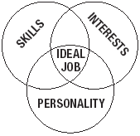
Choosing a Career
Things you like doing
Skills/abilities/aptitude
What you’re good at naturally
What kind of person am I? Do I prefer working on my own/with people?

Slide 42
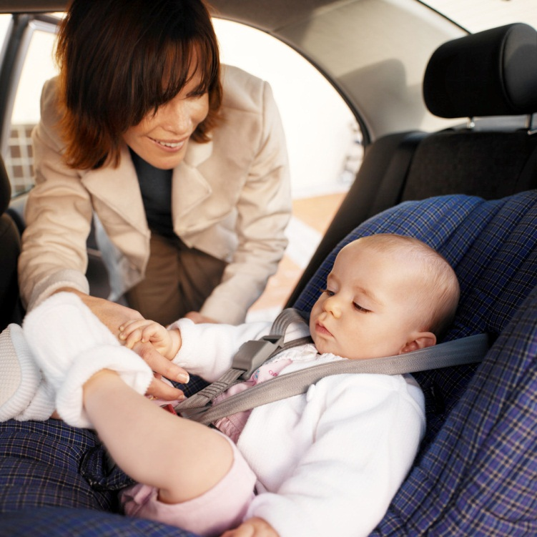
Not sure? Safe option
Irish
English
Maths
Language
At least one Science subject

Slide 43
Resources
www.curriculumonline.ie Syllabus for LC Subjects
www.examinations.ie Look at past exam papers
www.qualifax.ie Check entry requirements
www.careersportal.ie Read about all LC Subjects
College websites www.ul.ie www.lit.ie www.mic.ul.ie
College Prospectuses
Guidance Counsellor→ make an appointment
Teachers
Senior Cycle Textbooks

Slide 44
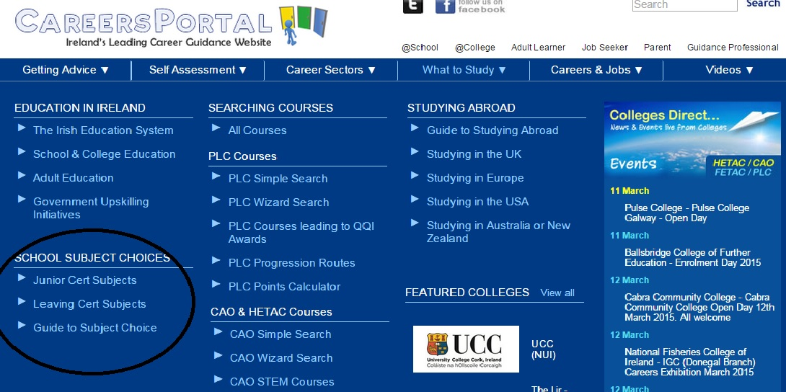
www.careersportal.ie

Slide 45

Language Entry Requirements for Third Level
Two languages (English + One other) required for the following colleges:
  Trinity College
  Dublin Institute of Technology
  Dublin City University -
  University of Limerick
  you can use a Pass in Irish of a European language – unless it is required for a particular course

Slide 46
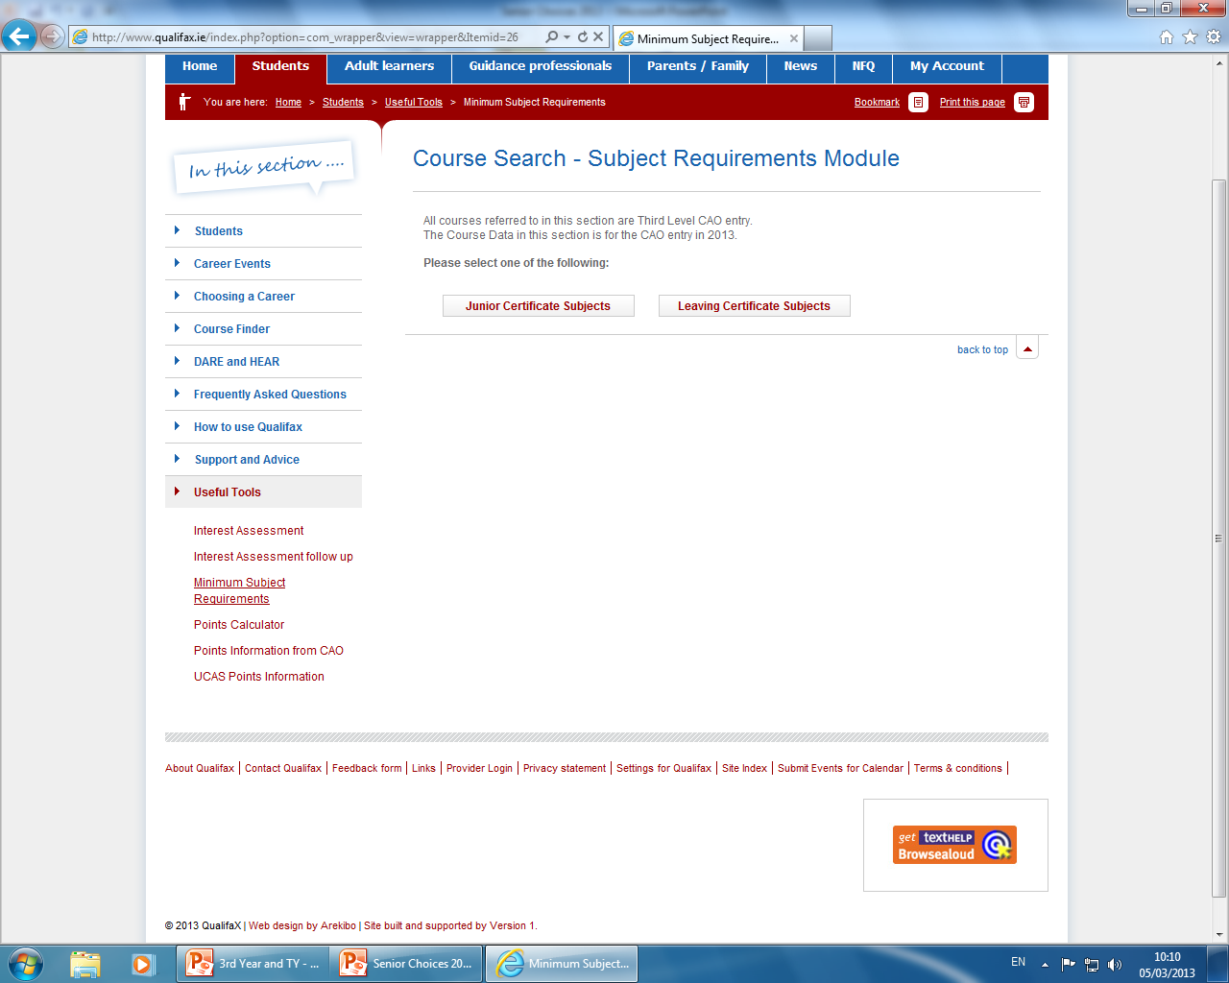
Language Entry Requirements for Third Level
Cadetships in the Army, Army equitation, Air Corps and Naval Service.
  3 HC3 and 3OD3
  Irish +English + European Language
For the Gardaí - two languages are required
A European Language is not required for entry to the Institutes of Technology, unless it is part of the area of study

Slide 47
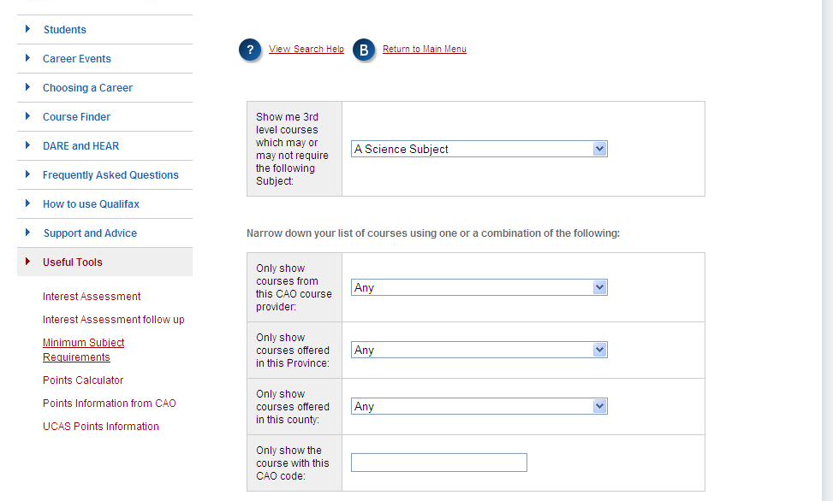

Subject Requirements
Science courses: Science Subject
Engineering: Honours Maths

Slide 48
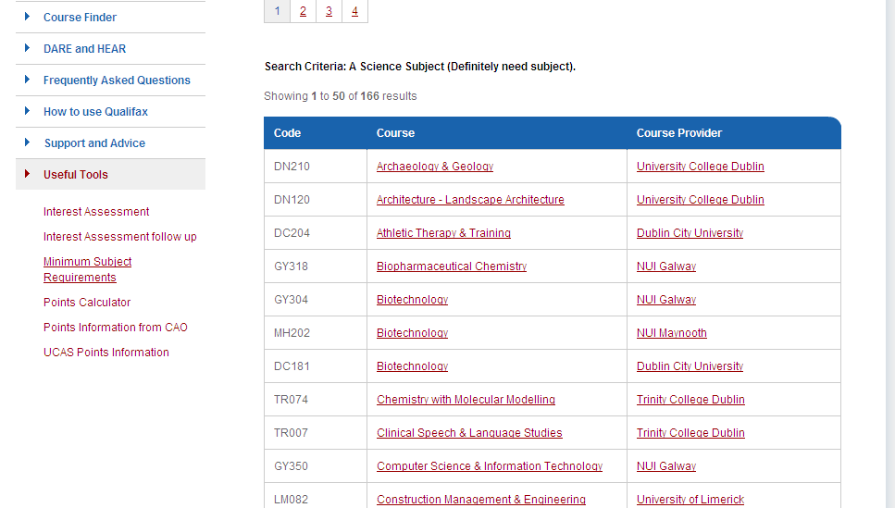

Slide 49
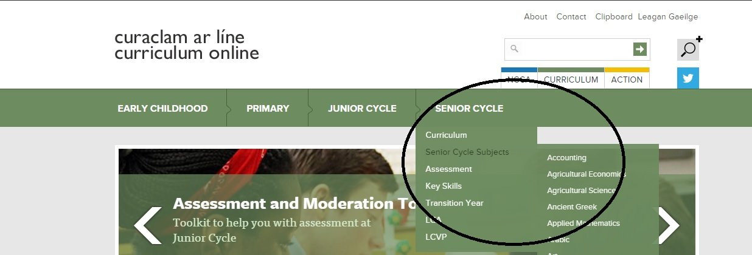
www.curriculumonline.ie

Slide 50
Research…
CAO App www.cao.ie
Qualifax/Student/useful tools/minimum entry requirements/Leaving Cert Subjects→ Choose a subject and check the implications of not choosing
Qualifax/Student/coursefinder/higher education CAO/Keyword + Search
  Main sections of interest:
  LC Entry Requirements
  Course Content
  Subjects taught
  Careers or further progression

Slide 51

Follow Ms.Daly on Instagram
Twitter @stannescck

Slide 52
Final words….
It’s important not to lock yourself out of a course you want to study by not choosing a required subject.
Do your research.
Different colleges can have different requirements for the same course

Slide 53
Note the following:
Numbers for particular classes may be limited e.g practical subjects 20/24 max
In so far as possible students will be given their subject choice
It is very important when choosing the subjects to put them in preference order
You must complete form from 1-6

Slide 54
What next?
Complete the option form and return to Ms. Walsh ONLY by Monday March 14th
You must complete 1-6
Any extra information please write on the front of the form
Be sure to complete the section listing the four JC Subject Options
Please complete the phone number section so we can contact you if we need to

Slide 55
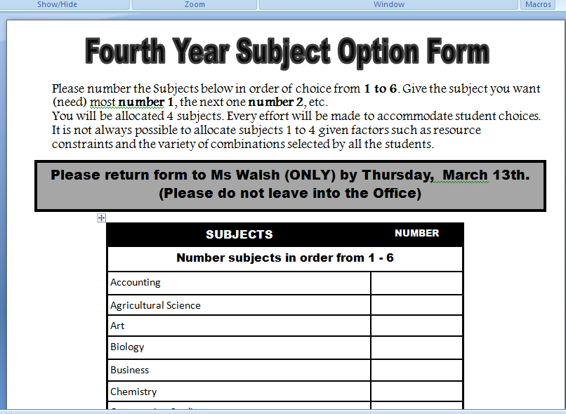
The Form

Slide 56
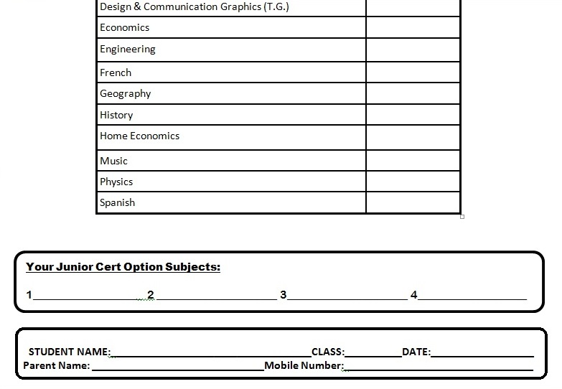
The form

Slide 57

What not to do!

Slide 58

What I hope you will all do!

Slide 59
Guidance Counsellor
061 620087
Fiona.daly@lcetb.ie

Slide 60


Slide 61
ST. ANNE’S
COMMUNITY COLLEGE
TRANSITION YEAR PROGRAMME
AN OVERVIEW
Information Session

Slide 62
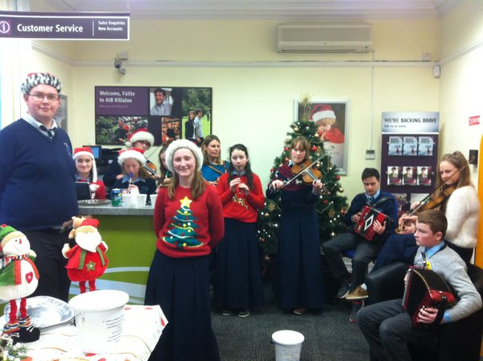
HISTORY OF TRANSITION YEAR
Introduced in 1973.
Mainstreamed in 1994.
Nationally two thirds of Post-Primary schools have TY Programme.
30,000+ students participate in the TY Programme annually.
Highly regarded internationally.

Slide 63
WHAT IS TRANSITION YEAR?
One year school based programme between Junior and Senior Cycle .
It provides a bridge to enable students make the transition from Junior to Senior cycle.
It offers students a broad variety of learning experiences inside and outside the classroom.
An exciting and innovative way of learning for students.

Slide 64
WHY WAS
TRANSITION YEAR INTRODUCED?
Until recently Irish students left school at a younger age than their European counterparts.
The need to encourage personal and social development.
The failure rates and high drop-out rates at third level.
To give students more educational opportunities.

Slide 65
Why Opt for Transition Year?
Challenges Facing Young People
The Leaving Certificate &
Points Race.
As a result of doing the TY Programme the students:
Make more informed subject choices.
Have improved study skills.
Are more independent learners.
Make better CAO choices and meet course requirements.
Grow as people and participate more in the school and local communities.

Slide 66
Why opt for Transition Year?
Challenges Facing Young People
Third Level :
High drop out rate
Transition Year increases:
Age Profile/Maturity.
Independence and Personal Development.
A Variety of Skills including Group, Project-work ,Research Skills, Etc.
I.C.T. skills.
Greater knowledge and Experience of the World of Work and Business.
Social Consciousness.

Slide 67
Why opt for Transition Year?
Challenges Facing Young People
Adult and Working Life :
Transition Year helps students to build:
Confidence and Assertiveness.
Teamwork Skills.
Maturity /Critical Judgement.
Careers / Work Experience /Community Involvement.
Interviews – C.V. , Portfolios, Business Plans.
Technical and Practical Skills.
I.C.T. Skills /Word-Processing/Presentations and
Public-Speaking.

Slide 68
AIMS.
Education for
MATURITY
with emphasis on
social awareness
& increased social
competence
Promotion of general,
technical and academic
SKILLS with an
emphasis on
interdisciplinary and
self-directed learning
Education through
experience of ADULT
& WORKING LIFE
as a basis for personal
development & maturity
Notes:
Attitudes/ skills/ knowledge
Process nt product
3 Ts – thinking/ teamwork/ technology

Slide 69
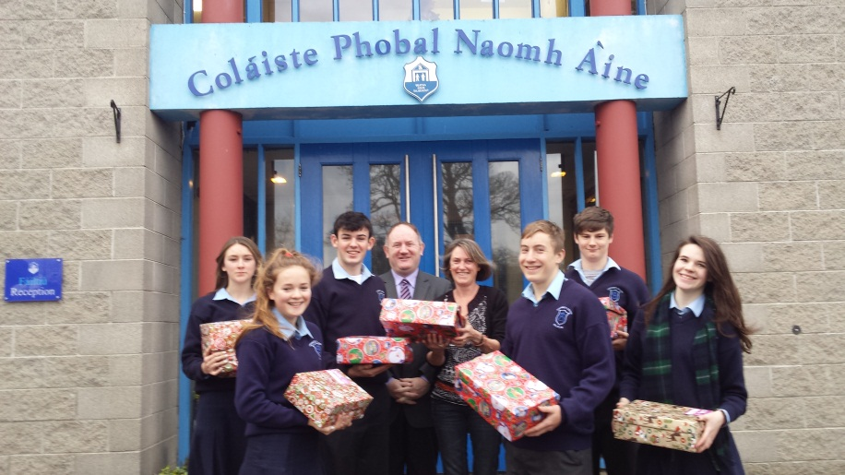
THE LAYERS OF
OUR TY PROGRAMME.
1. CORE LAYER.
2.SUBJECT SAMPLING LAYER.
3. TRANSITION SPECIFIC LAYER.
4. CALENDAR LAYER.

Slide 70
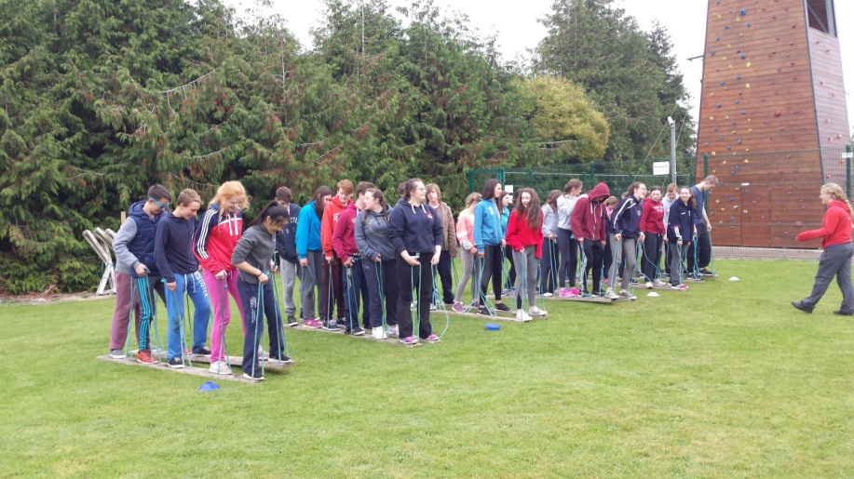
CORE SUBJECT LAYER
ENGLISH.
IRISH.
MATHS.
A FOREIGN LANGUAGE.

Slide 71
SUBJECT SAMPLING LAYER
ART.
WEB DESIGN.
HOME ECONOMICS & INTERNATIONAL CUISINE.
MATERIALS TECHNOLOGY.
MUSIC.
METALWORK.
SPEECH AND DRAMA.
SOLID WORKS.
WORLD OF SCIENCE.

Slide 72
TRANSITION SPECIFIC LAYER
MINI-COMPANY.
SCHOOL BANKS.
VARIETY OF SPORTING ACTIVITIES.
FIRST AID.
YOUNG SOCIAL INNOVATORS.
HEALTH AND SAFETY.
ENVIRONMENTAL AWARENESS.
RELIGIOUS EDUCATION AND SOCIAL OUTREACH.

Slide 73
SAMPLE CALENDAR LAYER.
WORK EXPERIENCE PLACEMENTS.
VISITING SPEAKERS.
OUTDOOR PURSUITS.
EXCURSIONS.
CONCERT/SCHOOL MUSICAL.
SOAR FOUNDATION.
ADVENTURE WEEKEND/SCHOOL TOUR

Slide 74
BALANCE IN THE T.Y. CURRICULUM.
TRADITIONAL SUBJECTS. NEW MODULES.
Didactic Teaching Methods. Active Teaching Methods.
ACADEMIC SKILLS. SELF-DIRECTED LEARNING.
Class based learning. Out of school activities.
BASIC STUDY HABITS. THE CAPACITY TO WORK IN GROUPS.

Slide 75
METHODOLOGIES
Active & Learner-focused.
Teacher as Facilitator.
Group-work / Pair-work.
Role-play /Simulations.
Project work /Field-work.
Out-of-school Activities.
Visiting Speakers.
Practical-Work.
Notes:
Learning pyramid
This list is not comprehensive
This is the aspiration! – actually is happening in classrooms though- and the re is a spill-over into other classes

Slide 76
ASSESSMENT.
STUDENTS ARE ASSESSED
ON ALL ASPECTS OF THE PROGRAMME
USING A VARIETY OF TECHNIQUES:
School Journal.
Oral Presentations.
Aural Assessment.
Project-Work.
Self-Assessment.
Written and/or Practical Class Tests.
Displays of Work.

Slide 77
CERTIFICATION.
Certificate from St. Anne’s Community College.
STUDENTS WILL BE ASSESSED ON:
Participation.
Enthusiasm.
Commitment.
Progress Throughout the Year.
How the Students Apply Themselves to the Programme.

Slide 78
POINTS TO CONSIDER
ABOUT TY.
Why do I want to do TY?
Don’t Base Your Decision on What Your Friends Want to Do!
4th year Subject Options – Tasters in TY.
Am I Ready For Senior Cycle?
Am I Excited About the Opportunities TY Presents?

Slide 79
Finance
TOTAL FEES FOR 2016-2017: €440.
€80 Deposit with Application Form
€180 May
€180 September
Make cheques payable to LCETB please

Slide 80
EXPECTATIONS OF STUDENTS DURING TY.
Actively participate in all the opportunities offered.
Develop work and study habits appropriate to senior cycle.
Establish positive and respectful relationships with fellow students and teachers.
Participate in class work and complete homework and other assignments on time and to the required standard.

Slide 81
KEY TO SUCCESS.
PARTICIPATION.
GOOD ATTENDANCE.
POSITIVE RELATIONSHIPS.
FLEXIBILITY.
OPENNESS TO LEARNING NEW THINGS.
GIVE IT A GO.

Slide 82
TY IS AN OPPORTUNITY TO DEVELOP
3RS Reading, Writing, Arithmetic.
3TS Thinking, Teamwork, Technology.
3LS Life skills, Learning, Leisure.

Slide 83
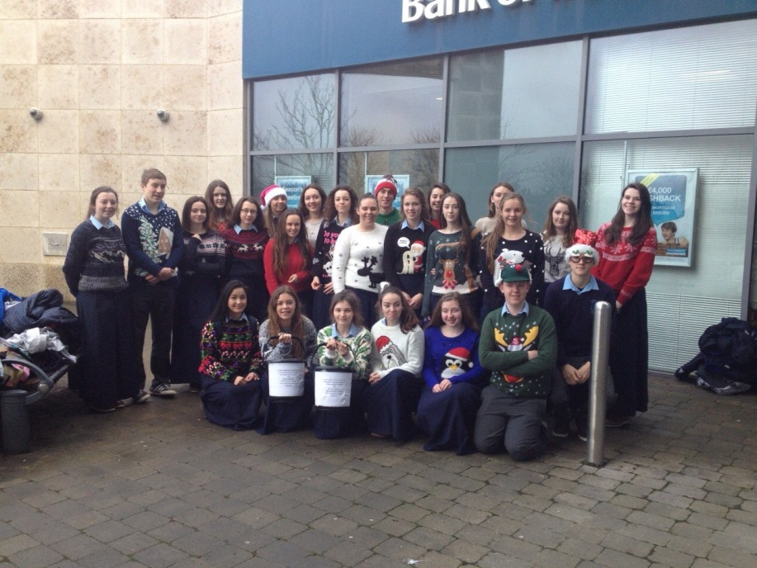
RESEARCH FINDINGS on Transition Year

Slide 84
RESEARCH FINDINGS (1)
The ESRI Study “The Transition Year Programme-An Assessment” has established that students who had taken the TY programme had a Higher Grade Point Average in the Leaving Certificate as well as Increased Entry Level to Higher Education. Students were also found to take a Broader Range of Courses at third level than non TY students.

Slide 85
RESEARCH FINDINGS (2)
NCCA STUDY
Found that Leaving Cert students who had taken TY Programme were more likely to:
Be educationally adventurous.
Retain subjects at higher level.
Take up subjects they had not taken before.

Slide 86
INSPECTORATE EVALUATION
The consensus among Principals, Teachers and Students is that the Transition Year Programme is a very worthwhile initiative………………It gives the students time to grow in maturity and to develop self-confidence.
(Inspectorate Dept. of Education)

Slide 87
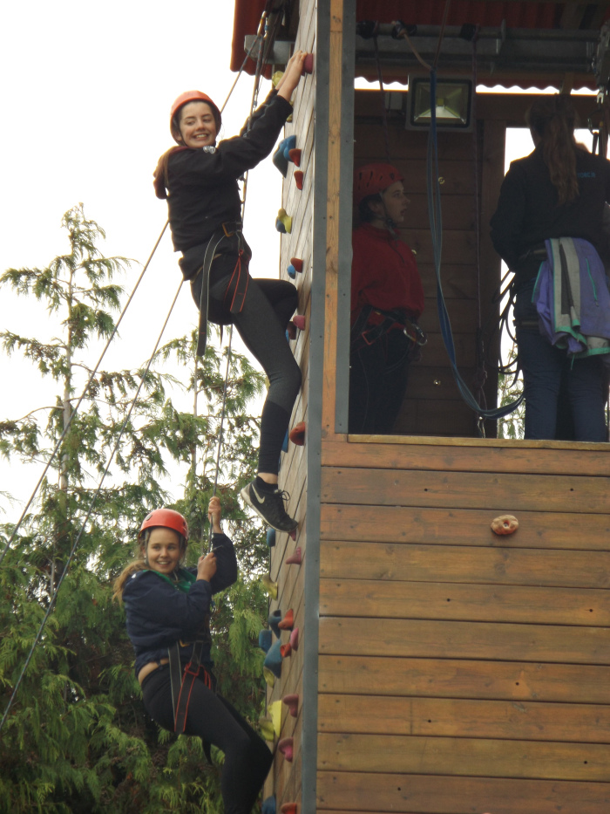
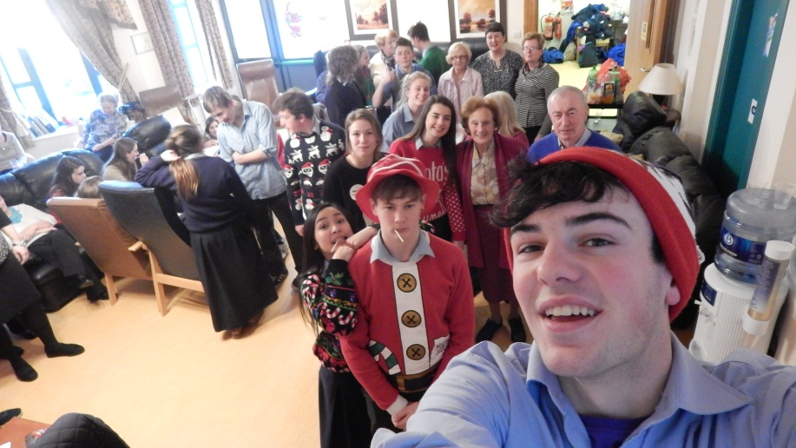

Slide 88
Questions

